Slide 1

Fault Analysis of Cryptosystems:
Attacks, Countermeasures, and Metrics
Debdeep Mukhopadhyay
Sikhar Patranabis
Department of Computer Science and Engineering
IIT Kharagpur
debdeep@cse.iitkgp.ernet.in
sikhar.patranabis@cse.iitkgp.ernet.in
http://cse.iitkgp.ac.in/resgrp/seal/

Slide 2
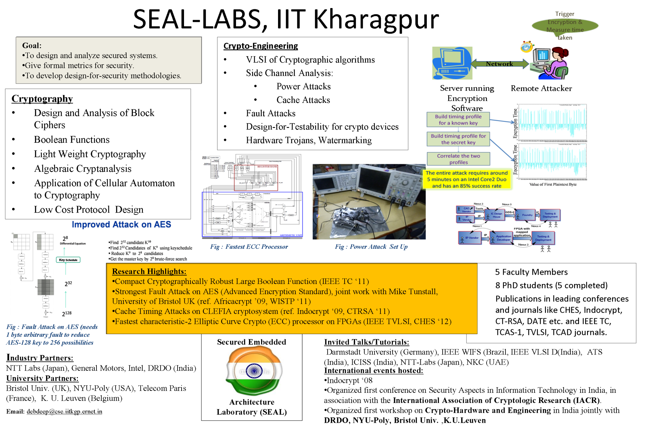

Slide 3
Fault Tolerance : Context in Cryptography
High-throughput requirements of various information disciplines.
Cryptographic accelerators are needed
  Hardware Designs implemented as ASICs and FPGAs.
  Raises concerns regarding their reliability.
Faults are catastrophic in context to security algorithms.
  AES can be broken with a single well-formed fault!

Slide 4
Types of Fault Attacks
Differential Fault Analysis (DFA)
  Induce a fault
  Observe the Difference of the correct and faulty pairs
  Derive equations to obtain the key
Differential Fault Intensity Attack (DFIA)
  Obtain non-uniform faults (biased faults) through non-expensive techniques
  Perform Side Channel Analysis like power analysis to exploit the bias

Slide 5
Fault Tolerant Architecture
Countermeasures to DFA
Detection Based Countermeasures
Based on application of Classical fault tolerant techniques to cryptography
Uses Various Forms of Redundancy
Infection Based Countermeasures
Tries to disturb the information of a fault by infection
No explicit detection step

Slide 6
Outline
Part 1: Brief History of Fault Attacks, Fault Models
Part 2: Differential Fault Analysis of Block Ciphers
Part 3: Countermeasures versus Biased Faults – Pushing the Limits
Part 4 : Fault Tolerance at a Granular Level : Idempotent Instruction Sequences
Part 5: Metrics for Fault Analysis

Slide 7
Brief History of Fault Attacks, Fault Models
PART 1

Slide 8
Techniques: Cryptographic Algorithms
encrypt
decrypt
plaintext message
plaintext message
ciphertext
SENDER
Key
(e)
Key
(d)
RECEIVER
retreat at dawn
sb%6x*cmf
retreat at dawn
ciphertext
ATTACKER

Slide 9
Fault Attacks : A Brief Overview
Introduction of faults in the normal execution of cryptographic algorithms and analysis of faulty output to obtain the key
First conceived in 1996 by Boneh, Demillo and Lipton
E. Biham developed Differential Fault Analysis (DFA) of DES
Today there are numerous examples of fault analysis of block ciphers such as AES under a variety of fault models and fault injection techniques
Popular Fault Injection Techniques – Clock Glitches, Voltage Glitches, EM and Optical Injection Techniques

Slide 10
Fault Attacks on RSA
(Boneh et al. 1996)
Only decryption is subject to attacks
Assume:
  1. Attacker can flip a single bit in key d 2. S and corresponding message M known to attacker
  Decryption device generates satisfying
  If then
  If then
Source : Koren and Krishna, Morgan-Kaufman 2007

Slide 11
Fault Attacks on RSA (contd.)
  Assume that the attacker flips randomly a bit in d.
Example: (e,N)=(7,77), d=43
  Ciphertext=37 producing M=9 if no fault is injected and if a fault is injected
  Search for i such that i=3 since
Source : Koren and Krishna, Morgan-Kaufman 2007

Slide 12
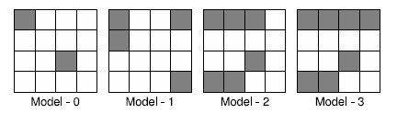
Fault Models
Transient Faults
  Single Bit Faults
  Single Byte Faults
  Diagonal faults
Stuck-at Faults
  Bit Faults
  Byte Faults
Instruction Skip Faults

Slide 13
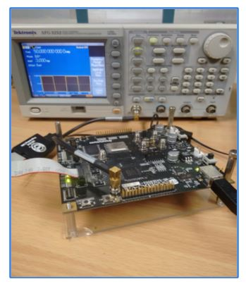
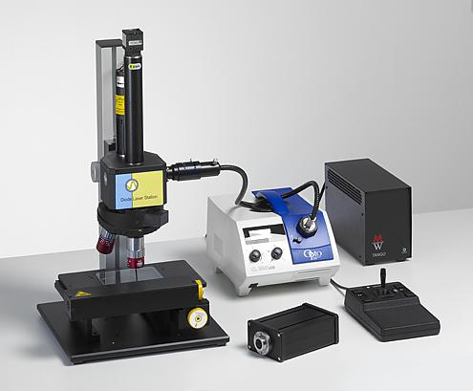
Fault Injection Techniques
Clock Glitches
Voltage Glitches
Electromagnetic Attacks
Optical attacks
Laser Guns

Slide 14
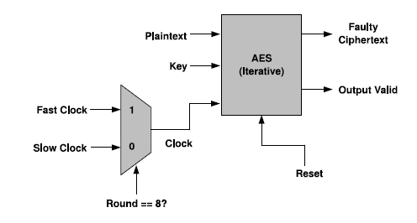
Fault Injection Setup : Clock Glitches
Tools Used:
  AES Core Implemented on Xilinx Spartan 3E.
  Tektronix Wave Form (120 MHz) Generator
  Xilinx Chipscope Pro Embedded Logic Analyzer.

Slide 15
Effect of Clock Glitches on Faults

Slide 16
When describing a fault attack on any cryptographic primitive, it is important to try and bridge the gap between theoretically and practically achievable fault models

Slide 17
Fault Attacks on Stream Ciphers
Fault Attacks threaten stream ciphers as well
A number of DFA attacks have been reported on stream ciphers such as Mickey and GRAIN-128
However, not all of these use realistic or practically achievable fault models
The assumption that uniformly random single bit flips can be obtained seems invalid in practical set-ups

Slide 18
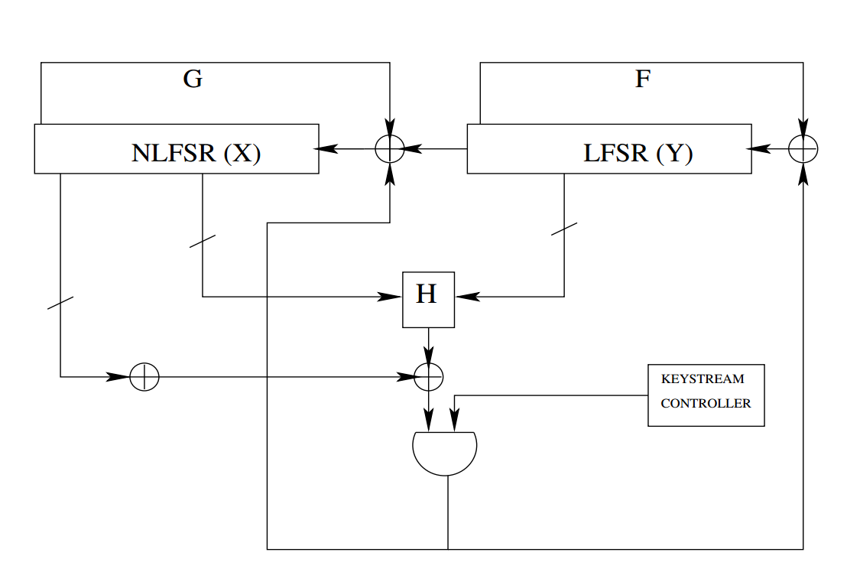
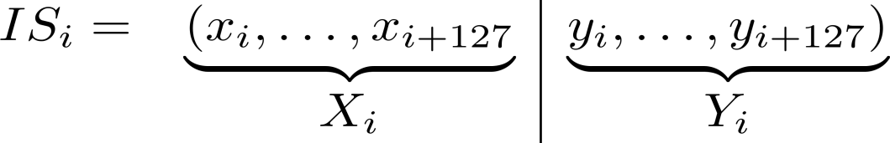
Grain-128 Stream Cipher
eSTREAM hardware port folio finalist
Designed by M. Hell, T. Johansson, A. Maximov and W. Meier

Slide 19
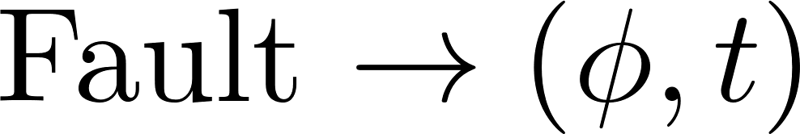
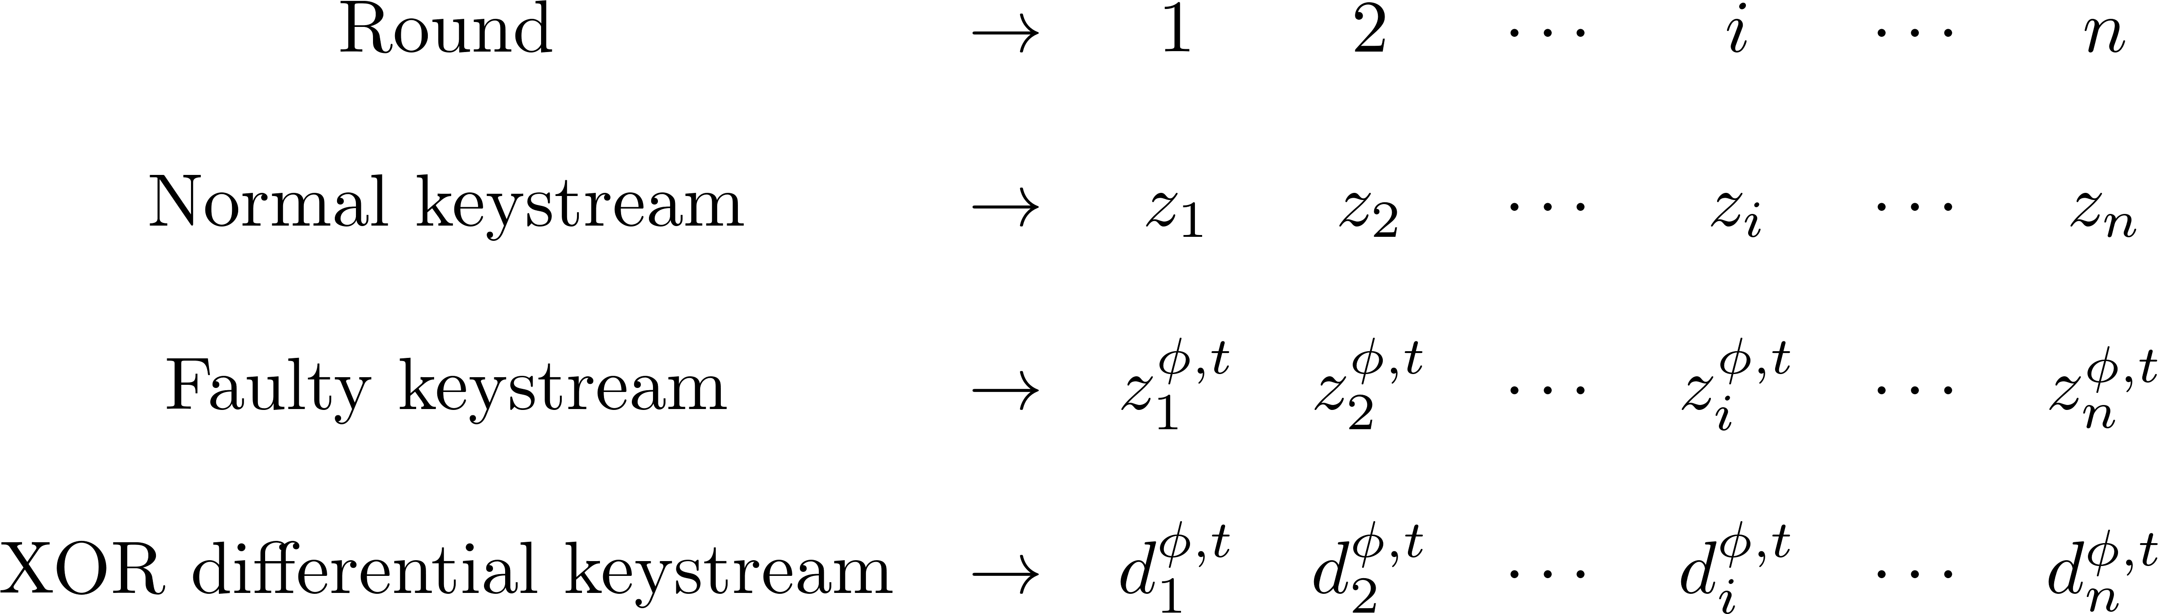

The XOR Differential Keystream
In order to detect the fault, one needs to identify a pattern in the XOR differential keystream
Prakash Dey, Abhishek Chakraborty, Avishek Adhikari, Debdeep Mukhopadhyay:
Improved practical differential fault analysis of grain-128. DATE 2015: 459-464

Slide 20
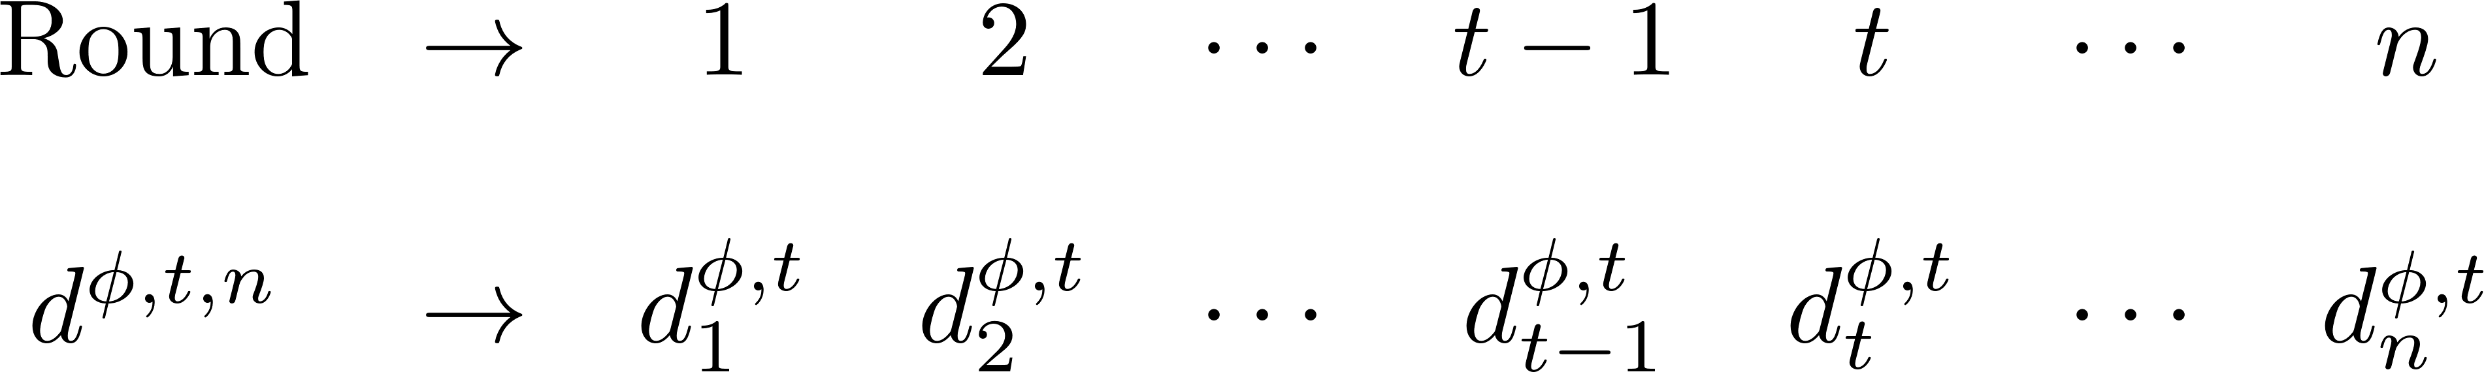


Signature of Faults
Key-IV independent Differential Pattern corresponding to a fault

Slide 21
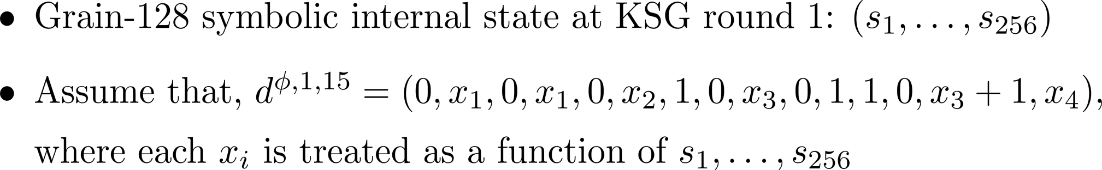
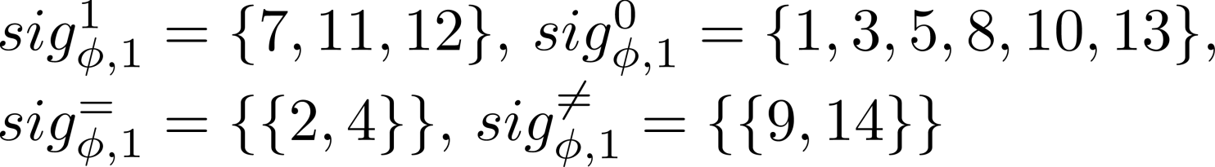
Signature: A Toy Example

Slide 22
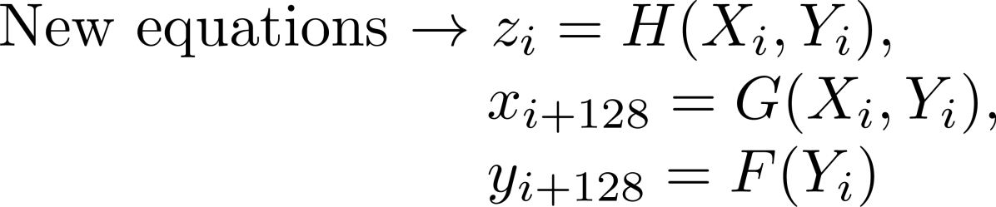


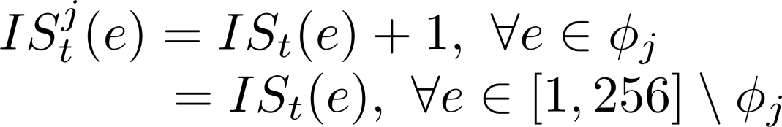
Generating Polynomial Equations
SAT solver

Slide 23
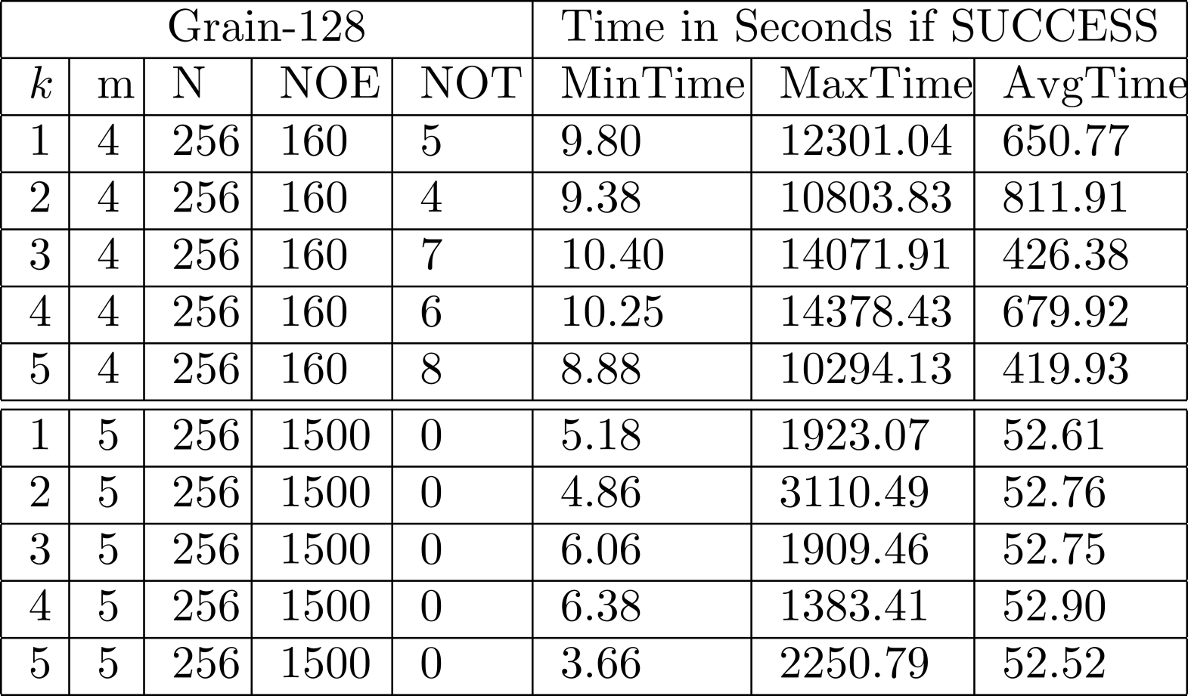
SAT Solving Results with timeout of 4 hours

Slide 24
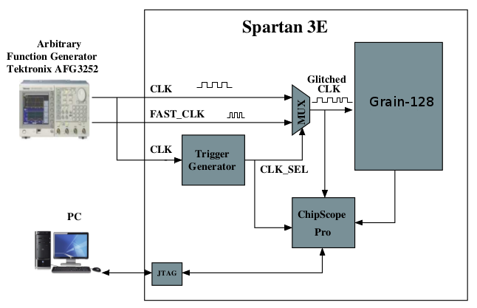
Fault Injection Technique
Spartan 3A

Slide 25
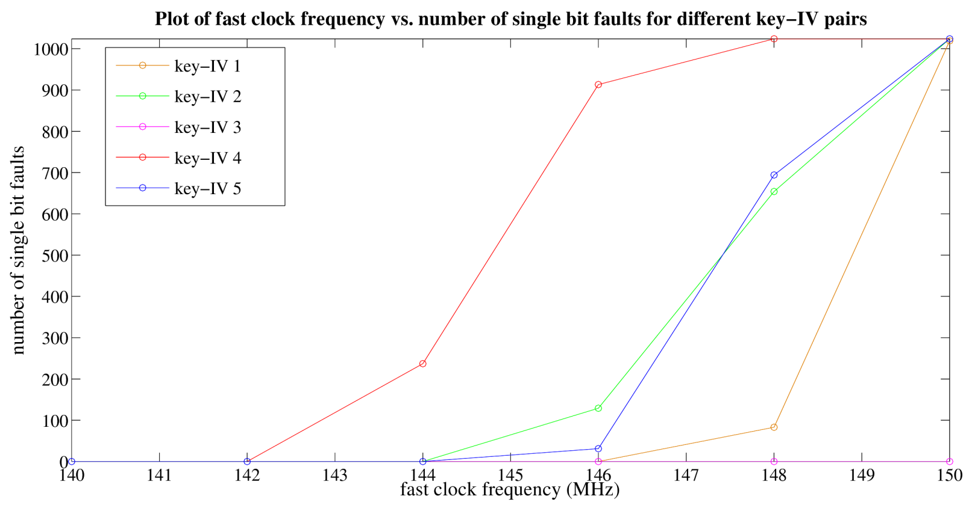
What happens in Practice?
All the faults were single bit faults
No multiple bit faults
Single bit faults biased at the 128th NLFSR bit

Slide 26
Grain-128 : Critical Path

Slide 27
Practically Achievable Fault Model
Many preceding fault attacks on stream ciphers assume a uniformly random fault distribution
However, fault injections using set-up time violations via clock glitches, for example, would lead to a very biased fault distribution since it is the critical path that would be violated each time
So it would not be practically feasible to obtain the same fault coverage as claimed under the uniform fault assumption

Slide 28
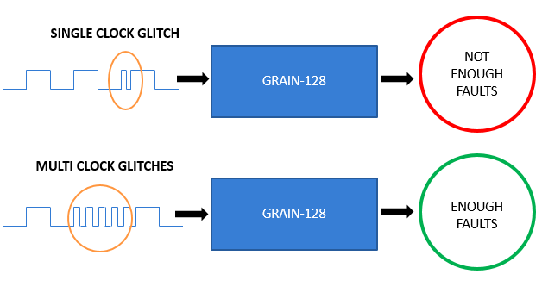
A More Realistic DFA of Grain-128

Slide 29

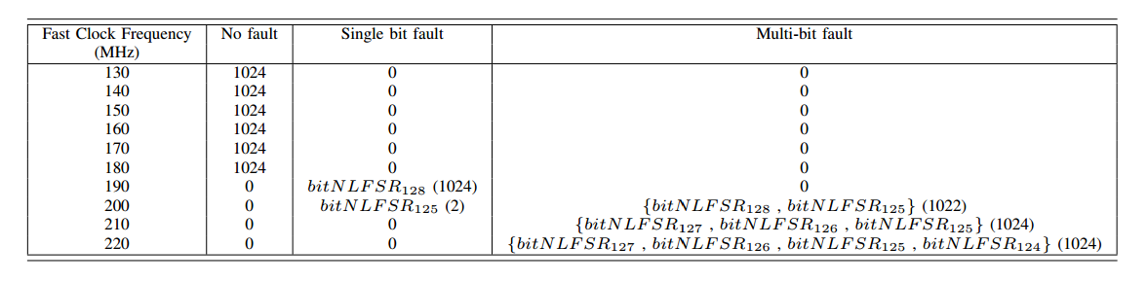
Introducing k- neighborhood faults

Slide 30
Summary of the Attack
Actual chip results of clock glitch induced faults on a stream cipher (Grain-128) were discussed
Occurrence of biased faults at a single bit
Existing single bit fault based DFA on Grain-128 will not be feasible
Modified fault injection technique: Combining the effect of the clock glitches and also the shift in the registers
Revisiting the DFA algorithm on Grain-128: Relaxed fault model with key recovery possible for k-neighborhood fault

Slide 31
Conclusions for Part 1
Fault Analysis
Adversary injects faults into cryptosystems and analyzes the faulty output to recover the key
Easy to perform, does not necessarily require high end equipment
Must design efficient countermeasures against fault attacks
Weakens even mathematically robust cryptosystems

Slide 32
Differential fault ANALYSIS OF BLOCK CIPHERS
PART 2

Slide 33
AES Algorithm: Our Target Cipher
PlainText
RoundKey
AddRoundKey
1st Round
SubBytes
SubBytes
ShiftRows
Repeat N_{r} -1 Round
ShiftRows
MixColumns
RoundKey
AddRoundKey
RoundKey
AddRoundKey
CipherText
First 9 Rounds
Last Round

Slide 34
Effect of Error on AES
Plaintext: 32 43 f6 a8 88 5a 30 8d 31 31 98 a2 e0 37 07 34
128-bit key: 2b 7e 15 16 28 ae d2 a6 ab f7 15 88 09 cf 4f 3c
Ciphertext: 39 25 84 1d 02 dc 09 fb dc 11 85 97 19 6a 0b 32
A single error in the plaintext: 30 43 f6 a8 88 5a 30 8d 31 31 98 a2 e0 37 07 34
Results in the ciphertext: c0 06 27 d1 8b d9 e1 19 d5 17 6d bc ba 73 37 c1
A single error in the key: 2a 7e 15 16 28 ae d2 a6 ab f7 15 88 09 cf 4f 3c
Results in the ciphertext: c4 61 97 9e e4 4d e9 7a ba 52 34 8b 39 9d 7f 84
A single-bit error results in a totally scrambled output
Source : Koren and Krishna, Morgan-Kaufman 2007

Slide 35
Illustration of a DFA
PLAIN TEXT
PLAIN TEXT
ENCRYPTION
ALGORITHM
ENCRYPTION
ALGORITHM
FAULT
INDUCTION
FAULT FREE
CIPHER TEXT
FAULTY
CIPHER TEXT
ANALYSIS

Slide 36
Types of DFA
Attack Location:
  Targeting the Data Path: Assume that the fault occurs in the AES data path.
  Targeting the AES Key Schedule: Assume that the fault occurs in the AES Key-schedule.
Fault Model:
  Single Byte
  Multiple Byte

Slide 37
Single Byte Faults in known DFAs
Single Byte Fault
  Attacker induces fault at the input of the 8th round in a single byte
  Fault value should be non-zero but can be arbitrary
Relaxing the requirements make the attack more practical
  No knowledge required of the fault value
  Lesser bytes needed to be faulty
  Lesser faulty cipher texts required

Slide 38
State of the Art: DFA in DataPath (AES-128)
Piret et. al 2003 (CHES): 2 faults for unique key, Time Complexity: 2⁴⁰
Mukhopadhyay 2009 (Africacrypt): 2 faults for unique key, Time Complexity: 2³²; showed attack possible with 1 fault.
Tunstall, Mukhopadhyay, Ali 2011 (eprint, WISTP): 1 fault, key space: 2⁸, Time Complexity: 2³²
Ali, Mukhopadhyay 2011 (eprint):Time Complexity: 2³⁰
Subidh Ali, Debdeep Mukhopadhyay, Michael Tunstall: Differential fault analysis of AES: towards reaching its limits. J. Cryptographic Engineering 3(2): 73-97 (2013)

Slide 39
A Practical Scenario:
An Iterated AES Architecture
AES Round
PLAINTEXT
STATE REG
STATE REG
CIPHERTEXT
Clk line
An Attacker can time his attack by counting the
number of clock cycles : Control on Fault Timing

Slide 40
Principle of the Attack
First, consider a single byte arbitrary fault at the input of the 9th round.
ISB : Inverse Sub Byte
We develop a filter, which takes as input the faulty and fault free ciphertext.

Slide 41
Propagation of Fault Induced
f
f’
f’
2f’
f’
f’
3f’
9th Round Byte
Sub
9th round
ShiftRow
9th Round
MixColumn
10th Round
ByteSub
F₁
F₁
F₂
F₂
F₃
F₃
F₄
F₄
10th Round ShiftRow

Slide 42
The Patterns Gives the Following Equations
ISB(x₁+K₁)+ISB(x₁+F₁+K₁)=
2[ISB(x₂+K₂)+ISB(x₂+F₂+K₂)]
ISB(x₂+K₂)+ISB(x₂+F₂+K₂)=
ISB(x₃+K₃)+ISB(x₃+F₃+K₃)
ISB(x₄+K₄)+ISB(x₄+F₄+K₄)=
3[ISB(x₂+K₂)+ISB(x₂+F₂+K₂)]

Slide 43
Important Points
No dependency on the fault value.
Finds out the key using two faulty encryptions with a probability of around 0.99
Rest of the cases a third faulty cipher text is needed
Time Complexity is 2¹⁶.
One byte fault reveals 4 key bytes.
  To obtain the entire key, 4 faulty cipher texts needed.

Slide 44
When the Fault is Induced in the 8th Round…
Fault is induced at the input of 8th round
A one byte disturbance creates a 4 byte fault at the input of the 9th round
Let us trace the disturbance through the last 3 rounds
Equations of similar nature…

Slide 45
Propagation of Fault Induced
f
f’
f’
2f’
f’
f’
3f’
9th Round
ByteSub
8th Round
Byte Sub
8th round
ShiftRow
8th Round
MixColumn
F₁
F₂
F₃
10th Round
Shift Row
10th Round
Byte Sub
9th Round
MixColumn
F₄
9th Round
ShiftRow
A₁
A₂
A₃
A₄
A₁
A₂
A₃
A₄
2F₁
F₄
F₃
3F₂
F₁
A₆
A₇
A₈
A₅
A₅
A₆
A₇
A₈
F₁
F₄
3F₃
2F₂
F₂
A₁₁
A₁₂
A₉
A₁₀
A₉
A₁₀
A₁₁
A₁₂
F₁
3F₄
2F₃
F₂
F₃
A₁₆
A₁₃
A₁₄
A₁₅
A₁₃
A₁₄
A₁₅
A₁₆
3F₁
2F₄
F₃
F₂
F₄

Slide 46
The Patterns Gives the Following Equations
ISB(x₁+K₀₀)+ISB(x₁+A₁+K₀₀)=
2[ISB(x₈+K₁₃) +ISB(x₈+F₂+K₂)]
ISB(x₈+K₁₃)+ISB(x₈+A₅+K₀₀)=
ISB(x₁₁+K₂₂)+ISB(x₁₁+A₉+K₂₂)
ISB(x₁₄+K₃₁)+ISB(x₁₄+A₁₃+K₃₁)=
3[ISB(x₈+K₁₃)+ISB(x₈+A₅+K₁₃)]

Slide 47

For the Other Key Bytes…
  Similar equations are derived for the other key bytes
For all the equations the worst case
complexity is around 2⁸ to 2⁹.
Two faulty cipher text pairs reveal the
exact key with a high probability.

Slide 48
Can the Attack Work with One Faulty Ciphertext?
With one faulty cipher text:
  Number of possible values per 4 bytes of the key is around 2⁸.
  There are 2³² possible candidates for 128 bits of the AES key.
  Brute force key is thus possible!
DebdeepMukhopadhyay, An Improved Fault Based Attack of the Advanced Encryption Standard. AFRICACRYPT 2009: LNCS 5580, pp 421-434

Slide 49
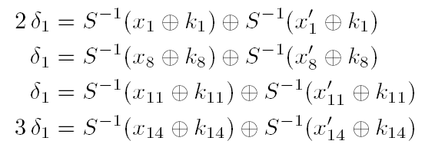
Why 2³²?
On an average there is one solution to the equation:
  S⁻¹(x) ^ S⁻¹(x ^ α)=β
Thus for one value of δ₁there is 1 value for k₁, k₈, k₁₁, k₁₄ which satisfies the equations.
Thus for all the 2⁸ values of δ₁, there are 2⁸ values for k₁, k₈, k₁₁, k_{14.}
Thus the total size of AES key is 2³²

Slide 50
Comparison of Existing Fault Attacks
Reference | Fault Model | Fault Loc. | #Faulty CT
Blomer | Force 1 bit to 0 | Chosen | 128
Giraud | Switch 1 bit | Any bit of chosen bytes | 50
Giraud | Disturb 1 byte | Anywhere among 4 bytes | 250
Dusart | Disturb 1 byte | Anywhere between last 2 MixColumn | 40
Piret | Disturb 1 byte | Anywhere between 7th& 8th round MixColumn | 2
Mukhopadhyay | Disturb 1 byte | Anywhere between 7th round MixColumn and last round input | 2

Slide 51
Comparison with Existing Fault Attacks Exploiting Key Scheduling
Reference | No. of fault injection points | No. of faulty encryptions | Brute force search
Takahashi et. al. (NTT Lab) | 1 2 3 | 2 4 7 | 2¹⁸ 2¹⁶ 0
Takahashi et. al. (NTT Lab) | 1 3 | 2 7 | 2⁴⁰ 0
Our Attack | 1 1 | 2 1 | 0 2³²

Slide 52
Improvement of the Attack
Current research shows that the AES key size can be reduced from 2³² to 2⁸ for a single byte fault.
The small complexity of the attack makes it feasible on real life FPGA implementations of AES using less sophisticated techniques, like clock glitching.
Michael Tunstall, Debdeep Mukhopadhyay, S,Ali, Differential Fault Analysis of the Advanced Encryption Standard using a Single Fault, Cryptology ePrint Archive: Report 2009/575, WISTP 2011

Slide 53
Drawbacks of Existing DFA
Requires 2³² brute-force search
Time complexity O(2³²).

Slide 54
Improving The DFA
The attack is improved in two ways:
    Reduce the search space of the attack
    Reduce the time complexity of the attack

Slide 55
Reducing the Search space
Search space reduced in two phases.
First phase:
    Find the 2³² candidates of 10th round key.
Second phase
    Deduce four differential equation from differences {2f’,f’,f’,3f’}.
    Reduce the 2³² candidates to 2⁸ using the four differential equation.

Slide 56
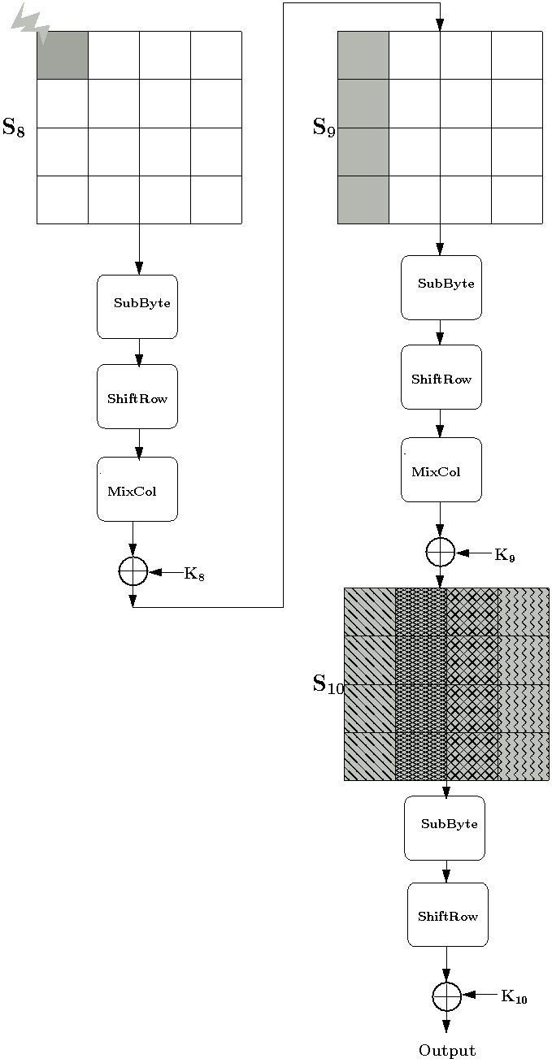
Reducing the search space
Find 2³² candidates K₁₀
Differential Equation
2³²
2¹²⁸

Slide 57
Reducing the Search space
2⁸
Find 2³² candidates K¹⁰
Find 2³² Candidates of K⁹ using keyschedule
Reduce K⁹ to 2⁸ candidates
Differential Equation
keyschedule
2³²
Differential Equation
2¹²⁸

Slide 58
Reducing the Search space
2⁸
Find 2³² candidate K¹⁰
Find 2³² Candidates of K⁹ using keyschedule
Reduce K⁹ to 2⁸ candidates
Get the master key by 2⁸ brute-force search
Differential Equation
keyschedule
2³²
Differential Equation
2¹²⁸

Slide 59
Results
Requires 2⁸ brute-force search.
Time complexity 2³²

Slide 60
Reducing Time Complexity
Existing DFA required to test 2³² candidates of K₁₀ by the 8th round differential equation.
(1)
(2)
(3)
(4)
Equations (2) and (3) does not contain key byte k₀ and k₁

Slide 61
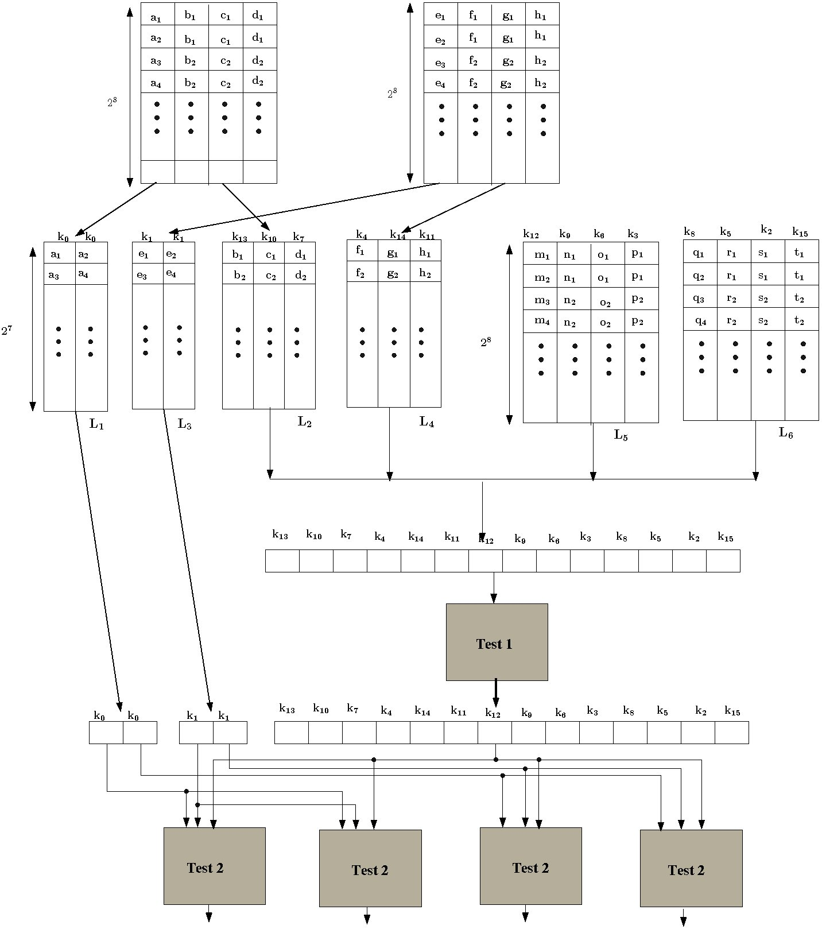
Reducing Time Complexity (Cont.)
First and the fourth quartets
Second and third quartets
Test by equation (2) and (3)
Test by equation (1) and (4)

Slide 62
Results
Time complexity of the attack reduced to 2³⁰ from 2³²
Attack is four times faster.
Ali, Mukhopadhyay 2011 (eprint):Time Complexity: 2³⁰

Slide 63
Effect of clock glitches on Faults: Are these faults practical?
DebdeepMukhopadhyay, "A New Fault Attack on the Advanced Encryption Standard Hardware”, ECCTD 2009, Antalya, Turkey (Invited Paper ).

Slide 64
Multi-byte Fault Attacks on AES

Slide 65
AES Algorithm
PlainText
RoundKey
AddRoundKey
1st Round
SubBytes
ShiftRows
Repeat N_{r} -1 Round
SubBytes
MixColumns
ShiftRows
RoundKey
AddRoundKey
RoundKey
AddRoundKey
CipherText
First 9 Rounds
Last Round

Slide 66
Fault Model Used
Multi Byte Faults (more practical)
  Attacker induces fault at the input of the 8th round in some bytes
  Fault value should be non-zero but can be arbitrary
Improves the fault coverage.

Slide 67
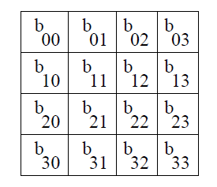
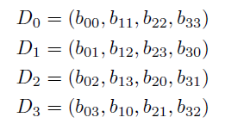
Diagonal of AES State Matrix
Diagonal: A diagonal is a set of four bytes of the state matrix,
where diagonal i is defined as follows:
According to the above definition and with reference to the state matrix of AES
(refer figure) we obtain the following four diagonals.

Slide 68
Fault Models
M0: One Diagonal affected.
M1: Two Diagonals affected.
M2: Three Diagonals affected.
M3: Four Diagonals affected.

Slide 69
Fault Injection Setup
Tools Used:
  AES Core Implemented on Xilinx Spartan 3E.
  Agilent Wavefrom (80 MHz)Generator
  Xilinx Chipscope Pro Embedded Logic Analyzer.

Slide 70
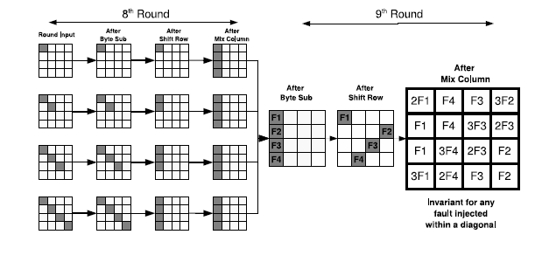
Equivalence of Faults according to M0
Faults induced in Diagonal D₀ at the input of 8th round AES are all equivalent.

Slide 71
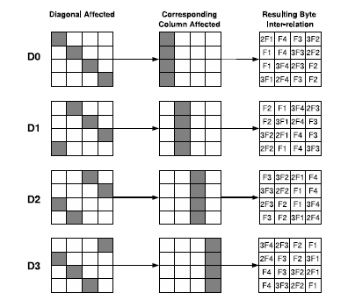
Inter-relationships depending on the Diagonals affected

Slide 72
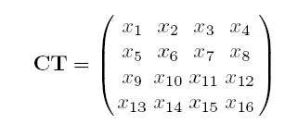
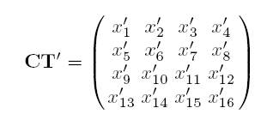
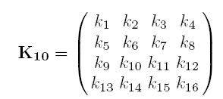
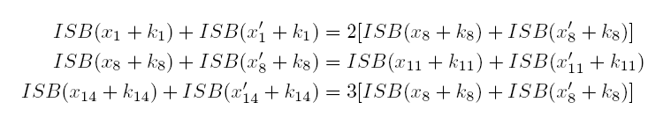
Equations if Diagonal D₀ is affected
There are in total 4 such systems of equations for a diagonal D₀.
Each system of equation gives 2⁸ keys on an average.
AES key size gets reduced to 2³².
If the attacker does not know which diagonal is affected, then key size is
4.2³²=2³⁴.

Slide 73
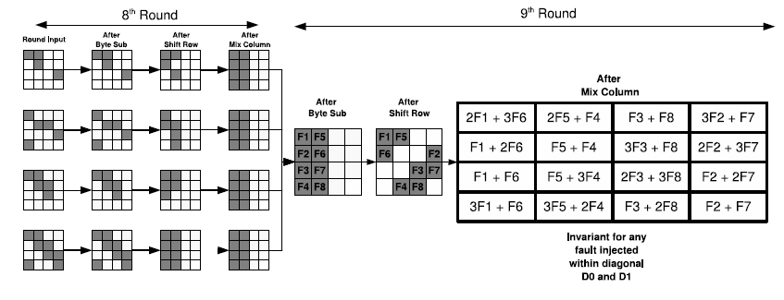
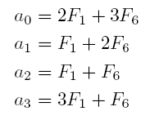

Fault Injected across 2 Diagonals
(Fault Model M₁)

Slide 74
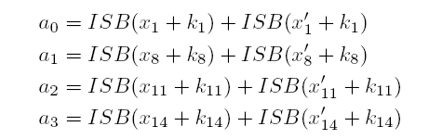
Equations if Diagonals D₀ and D₁ are affected
The equation reduces the space of the 4 key bytes of AES to 2¹⁶
Two faulty ciphertexts reduce it to a unique value on an average (experimental result).

Slide 75
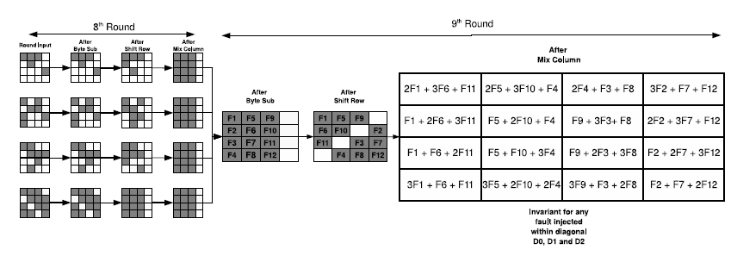
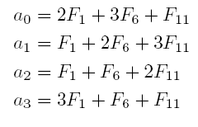

Fault Injected across 3 Diagonals
(Fault Model M₂)

Slide 76
Equations if D₀, D₁ and D₂ are affected
The equation reduces the space of the 4 key bytes of AES to 2²⁴
Four faulty ciphertexts reduce it to a unique value on an average (experimental result).

Slide 77
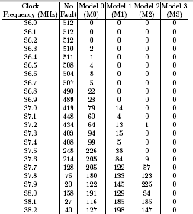
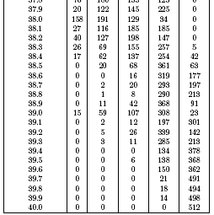
Experimental Results
ATTACK REGION

Slide 78
DFA on AES Key-schedule vs
DFA on AES datapath
Faults are induced in the Key-schedule.
Attacks on Key-Schedule show that a single byte fault, in the AES-128 keyschedule, reduces the AES key size to 2⁸ values:
  This result is analogous to the single byte fault induction in the AES-128 datapath, where also the remaining key size is 2³²
  However the time complexity in this present attack is 2³⁵, while for the datapath it was 2³⁰

Slide 79
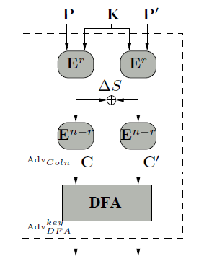
Reduction Proof for Optimality
Adv_{DFA}^{state}: Adversary against AES performing DFA on state.
Adv_{Coln}: Classical Adversary on AES.
Classical adversary searches for plaintexts P and P’ such that after a particular round r a target difference ΔS is created. Probability: Pr(ΔS ).
  K_{S}: Key space of AES wrt. classical cryptanalysis.
  K_{l}: Key space of AES wrt. DFA
  K_{l}≥K_{S}Pr(ΔS ).
Ali, Mukhopadhyay, Tunstall: Differential Fault Analysis of AES: Towards Reaching its Limits, Cryptology eprint 2012 (JCEN)

Slide 80
Optimal limit for a byte fault DFA
Assuming, K_{s}=2¹²⁸.
ΔS: Single Byte difference at the input to the eighth round.
  Pr(ΔS)=2⁻¹²⁰.
  Therefore, K_{l}=2⁻¹²⁰2¹²⁸=2⁸.
This analysis has been found to work for single byte fault attacks on AES-192, 256 and also for multiple byte faults.
Similar analysis can be also performed for DFA on key-schedules.

Slide 81
DFA of AES: Summary
Single fault for unique key recovery, Key Space: 2⁸ , Time Complexity: 2³²
Tunstall, Mukhopadhyay, Ali (WISTP 2011)
2011
2 faults for unique key recovery, Time Complexity: 2³²
Mukhopadhyay (AfricaCrypt 2009)
2009
2003
Demonstrated attack possibility with a single fault
Ali, Mukhopadhyay (eprint 2011) further reduced the time complexity to 2³⁰
Piret et. al. (CHES 2003)
2 faults for unique key recovery, Time Complexity: 2⁴⁰

Slide 82
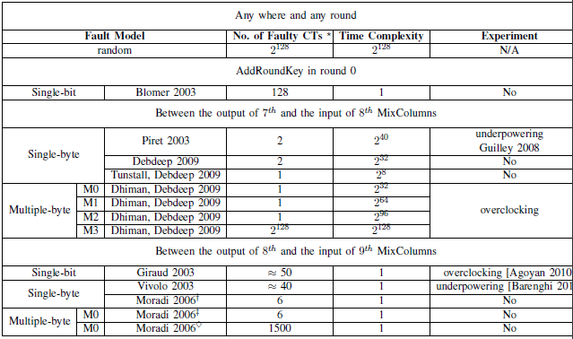
DFA Complexities

Slide 83
Conclusions for Part 2
Faults can be catastrophic for ciphers.
The leakage is so strong that all conventional ciphers are vulnerable against fault attacks.
Important to design suitable countermeasures: of particular interest to smart card industry
This brings a new spectrum to the design philosophy of ciphers to prevent fault analysis.

Slide 84
Countermeasures versus Biased Faults – Pushing the Limits
PART 3

Slide 85
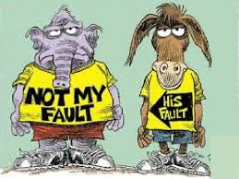
Countering Fault Attacks
Whose fault is It?
Is the flaw in the algorithm?
Is the flaw in the implementation?
How can Countermeasures be built?
Does Classical Fault Tolerance work?

Slide 86
Detection Based Countermeasures
Also known as Concurrent Error Detection (CED) techniques
Use various kinds of redundancy to detect faults
Vulnerable to attacks in the comparison step itself
Vulnerable to biased fault attacks

Slide 87
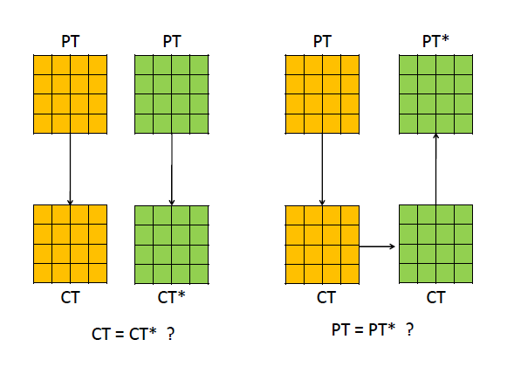
The Basic Principle of CEDs

Slide 88
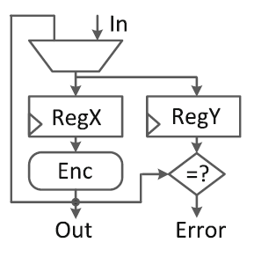
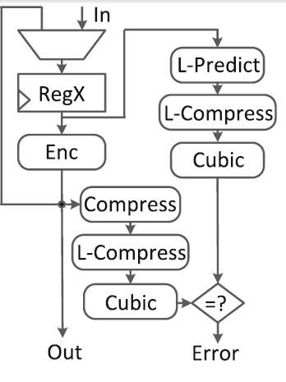
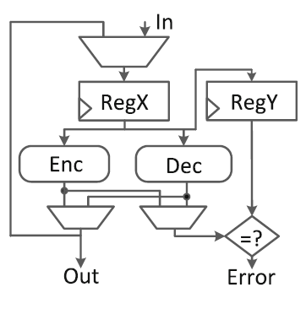
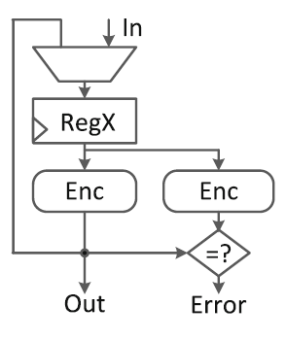
Examples of CED
Time Redundancy
Hybrid Redundancy - REPO
Information Redundancy – Robust Codes
Source : Guo et. al. , Security analysis of concurrent error detection against differential fault analysis – Journal of Cryptographic Engineering, 2014
Hardware Redundancy

Slide 89
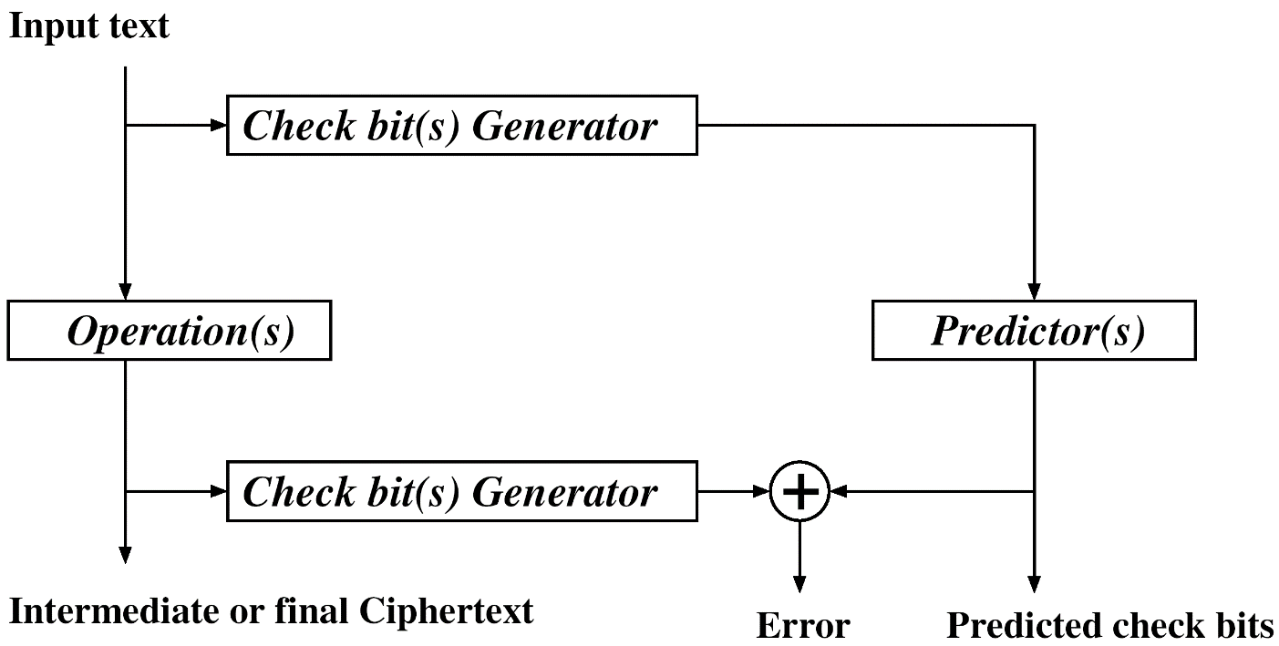
Error Detecting Codes (EDCs)
First generate check bits
For each operation within encryption predict check bits
Periodically compare predicted check bits to generated ones
Predicting check bits for each operation - most complex step
  Should be compared to duplication
Examples of EDC – parity based and residue checks
Can be applied at different levels – word, byte, nibble
Source : Koren and Krishna, Morgan-Kaufman 2007

Slide 90
Parity-based Code for AES
Operations operate on bytes so byte-level parity is natural
ShiftRows: Rotating the parity bits
AddRoundKey: Add parity bits of state to those of key
SubBytes: Expand Sbox to 256×9 – add output parity bit; to propagate incoming errors (rather than having to check) expand to 512×9 – put incorrect parity bit for inputs with incorrect parity
MixColumns: The expressions are:
where is the msb of
the state byte in position i,j
Transformation Input
(input state matrix)
Parity Bit(s)
Parity Prediction
Transformation
Predicted
Parity Bit(s)
Transformation Result
(output state matrix)
Source : Koren and Krishna, Morgan-Kaufman 2007

Slide 91
Does Detection Always Guarantee Security?

Slide 92
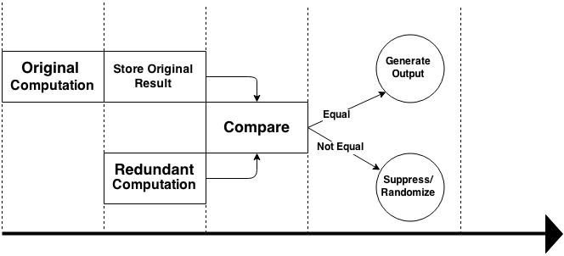
The Time Redundancy Countermeasure
  S.Patranabis, A.Chakraborty, P.H.Nguyen and D.Mukhopadhyay. A Biased Fault Attack on the Time Redundancy Countermeasure for AES. In Proceedings of Constructive Side Channel Analysis and Secure Design 2015 (COSADE 2015), Berlin, Germany, April 2015

Slide 93
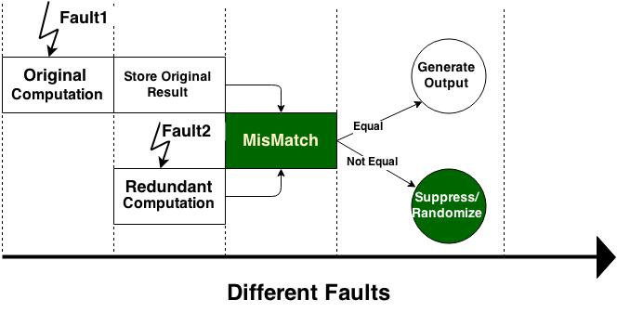
Against Double Fault Attacks : Detection

Slide 94
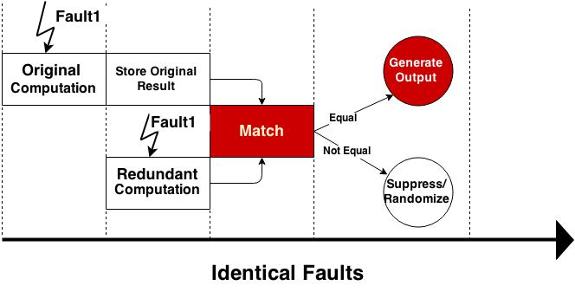
Against Double Fault Attacks: Misses

Slide 95
Beating The Countermeasure
Improving fault collision probability
  Enhancing the probability of identical faults in original and redundant rounds
Two major aspects
  The size of the fault space
  The probability distribution of faults in the fault space
A smaller fault space enhances the fault collision probability
A non-uniform probability distribution of faults in the fault space also enhances the fault collision probability

Slide 96
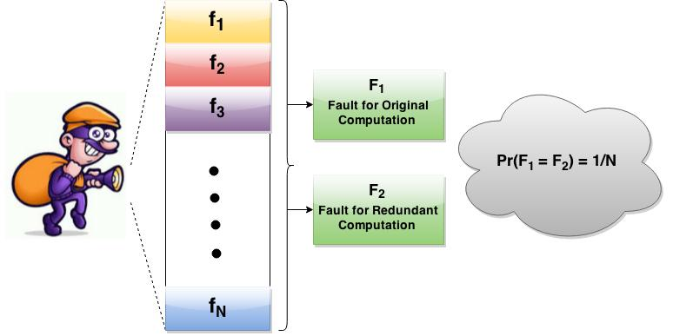
Uniform Fault Model
All faults are equally likely

Slide 97
Biased Fault Model
A total of n faults possible under a fault model F
Each fault fi has a probability of occurrence Pr[fi]
Let V be the variance of the fault probability distribution
Degree of Bias of a fault model increases with increase in V
Fault Model | Pr[f1] | Pr[f2] | Pr[f3] | Pr[f4] | Pr[f5] | Pr[f6] | Pr[f7] | Pr[f8] | V
1 | 0.125 | 0.125 | 0.125 | 0.125 | 0.125 | 0.125 | 0.125 | 0.125 | 0
2 | 0.225 | 0.200 | 0.175 | 0.125 | 0.100 | 0.075 | 0.050 | 0.050 | 0.004
3 | 0.500 | 0.250 | 0.125 | 0.050 | 0.050 | 0.025 | 0 | 0 | 0.026

Slide 98

The Fault Collision Probability
With increase in bias, collision probability increases

Slide 99

The Adversarial Perspective
But what about practical feasibility?
How can
we exploit
the bias?

Slide 100


Fault Intensity
The impact of fault varies with the tuning of the parameters of the fault inducing process.
More true for low cost equipment.
Insertion of Fault through Clock Glitches:
With increase of clock frequency more bits start getting affected.
We say the fault intensity increases!
Nahid Farhady Ghalaty, Bilgiday Yuce, Mostafa M. I. Taha, Patrick Schaumont:
Differential Fault Intensity Analysis. FDTC 2014: 49-58

Slide 101
Differential Fault Intensity Analysis (DFIA)
Combines fault injection and DPA principles
Induces biased faults by varying the fault intensity
Applies a hypothesis test with biased faults
Uses biased faults as the source of leakage

Slide 102


Steps of a DFIA
The extraction of the key is like a side channel analysis:
Guessing the key correctly helps in observing the bias in the fault distribution

Slide 103


Attack on the Time redundancy Countermeasure
Suitable
All faults are restricted to a single byte
Two kinds of fault models
  Situation-1: Attacker has control over target byte
  Situation-2: Attacker has no control over target byte
Control over target byte makes fault model more precise but is costly to achieve

Slide 104


The Fault Injection Set-Up
Time redundant AES-128 implemented in Spartan 3A FPGA
Fault injection using clock glitches at various frequencies
Xilinx DCM to drive fast clock frequency
Internal state monitoring using ChipScope Pro 12.3

Slide 105




The Attack Procedure
Fault Distribution
Distinguishers used :
  Hamming Distance (HD)
  Squared Euclidean Imbalance (SEI)
Make a key hypothesis k and evaluate the distinguishers
Correct hypothesis gives minimum
and maximum values respectively

Slide 106

Simulations-1
Number of ciphertexts required to guess the AES key with 99% accuracy
Identical faults introduced into both original and redundant rounds
Target byte chosen at random
  Same fault for original and redundant computations
  Each fault injection yields a useful ciphertext
Attacks simulated on rounds 8 and 9
Performed separately for each fault model
Simulation results

Slide 107
Simulations-2
Vary the degree of bias in the fault model
  Control the variance of the fault probability distribution
Observe the number of fault injections to get a faulty ciphertext
Two adversarial models:
  Type 1: Perfect control over target byte
  Type 2: No control over target byte

Slide 108


Simulations-2 (contd.)

Slide 109

Experimental Results
Useful ciphertexts
Total Fault Injections

Slide 110
Comments on Detection Schemes
Bias of a fault model can be quantified in terms of the variance of fault probability distribution
Detection based countermeasures are vulnerable against biased fault attacks that are practically achievable

Slide 111

Fault Tolerance for DFA needs to be revisited?
Cover all of the essential
or
almost all???

Slide 112
Countermeasures Must Be Augmented
Detection alone does not guarantee security against fault attacks, especially in the wake of biased fault models
Need to augment the countermeasure scheme to tackle biased fault attacks
Two possible strategies:
  Fault Space Transformation
  Infective Countermeasures

Slide 113
Fault Space Transformation
Ensure that the adversary cannot exploit the biased nature of the fault model
Fault spaces for the original and redundant computations are different
Adversary cannot ensure the occurrence of equivalent faults in the two different fault spaces at the same time.

Slide 114


Fault Space Transformation to Counter Biased Fault Attacks
Sikhar Patranabis, Abhishek Chakraborty, Debdeep Mukhopadhyay, P. P. Chakrabarti:
Using State Space Encoding To Counter Biased Fault Attacks on AES Countermeasures. IACR Cryptology ePrint Archive 2015: 806 (2015)

Slide 115
The Impact of Transformation
Transforming the fault space implies that the adversary cannot beat the countermeasure by merely introducing the same fault twice
It is most unlikely that the transformed fault space will have a one-to-one correspondence in terms of bias with the original
Mathematically, the expected fault collision probability over all possible transformations is the same as for uniform fault models

Slide 116

Results on Hardware
Transformation used is the MixColumn of AES
Peaks occur at disjoint frequency regions
Single Bit Upset (SBU)
Single Byte Double Bit Upset (SBDBU)

Slide 117
Infective Countermeasures
The main initial idea behind infective countermeasures was to diffuse the impact of the fault such that even if the adversary were to attack the comparison step, the state would still be affected

Slide 118

The Infection Mechanism
Source : Lomne et. al. , On the Need of Randomness in Fault attack Countermeasures – Application to AES, FDTC 2012

Slide 119
Infective Countermeasures : State of the Art
Tupsamudre et. al. proposed a randomized infective countermeasure in CHES 2014
Since 2014
Gierlichs et. al. proposed in LatinCrypt 2012 a randomized infective countermeasure that totally does away with explicit consistency checks by clever use of random and dummy rounds
2012-2014
Prior to
2012
Fournier et. al. and Joye et. al. suggested infective countermeasure schemes using deterministic diffusion functions
Proved to be inherently insecure by Lomne et. al. in FDTC 2012
Propagation of faults prevents an attacker from being able to conduct any fault analysis of corrupted ciphertexts
Proved to be insecure against attacks on the last round by Battistello et. al. in FDTC 2013 and Tupsamudre et. al. in CHES 2014
Addresses several pitfalls of the earlier infective countermeasure scheme
Does not provide any formal proofs of security
Does not consider attacks where the execution order of instructions could be changed
Used consistency checks between cipher and redundant computations

Slide 120

CHES 2014 Infective Countermeasure

Slide 121


CHES 2014 Countermeasure (Contd.)
Correct Computation
Faulty Computation

Slide 122

Unexplored Territory-1
Formal Proof of Security
  A frequent criticism of infective countermeasures - no explicit formal proof of security

Slide 123

Unexplored Territory-||
The countermeasure provides security against fault attacks that target the state registers
What about faults that target the execution order of instructions instead?
For instance instruction skip attacks

Slide 124



Information Theoretic Proof of Security
Single Fault Injection
Infection upon detection of fault destroys any correlation between output differential ∆ and key K
Hence ∆ and K are independent
Sikhar Patranabis, Abhishek Chakraborty, Debdeep Mukhopadhyay:
Fault Tolerant Infective Countermeasure for AES : SPACE 2015

Slide 125

Security Proofs (contd.)
Multiple Fault Injection
  The adversary must introduce the same fault in a redundant-cipher round pair
  Not easy due to the presence of random intermediate dummy rounds in between
The Attack Probability for 30 Dummy Rounds

Slide 126




Security Proofs (contd.)
The Evaluation
We focus on the event e’ where an adversary introduces the same fault in a redundant-cipher round pair
Set of faults possible for key $k_{i}$

Slide 127
Conclusions for Part 3
Detection based countermeasures work well against classical uniform fault models
Redundancy alone is not enough to tackle biased fault attacks
Fault Space Transformation tries to make sure the adversary cannot introduce the same fault in the original and redundant rounds
Infective countermeasures attempt use intermediate dummy rounds to confuse the adversary and avoid explicit detection steps

Slide 128
Fault Tolerance at a Granular Level : Idempotent Instruction Sequences
PART 4

Slide 129
The Instruction Skip Fault Model
The adversary can skip an instruction
Equivalent to replacing instruction by a NOP
Practically achievable on a variety of architectures
  8-bit AVR microcontrollers
  32-bit ARM9 processor
  32-bit ARM Cortex-M3 processor
Variety of injection techniques possible - Clock glitches, EM Glitches, Voltage glitches and Laser shots

Slide 130

The Attack Idea
What if the adversary skips this step??

Slide 131



The Attack Procedure
Skip the increment of the round counter after the final redundant round
The last cipher round is replaced by a spurious redundant round
The adversary obtains the output of the 9th round
Replaced by a Redundant Round

Slide 132


The Information Leakage
Consider the event e that the attacker successfully performs the instruction skip to recover the key

Slide 133
The Loop Holes
Fixed ordering of redundant and cipher rounds
Fault in the redundant round is only detected in the next cipher round
No check if a redundant round being executed is valid
Round counter is not validated

Slide 134
Modified Infective Countermeasure
The relative ordering of cipher and redundant rounds is randomized
The intermediate output after each odd computation round is masked
Penultimate computation could be redundant or cipher
In either scenario, instruction skip gives a masked output that has no correlation with the key

Slide 135

Instruction Skips on the Modified Countermeasure
Must skip two instructions now – the round counter increment as well as the masking steps in two separate rounds
Practically feasible second order fault attack?

Slide 136

Some Comparisons

Slide 137
But what about other Instruction Skip instances ??

Slide 138
Fault Tolerance at the Instruction Level
Injection of faults in two instructions separated by only a few clock cycles is difficult to achieve in practice
Rewrite compiler generated assembly code by replacing each instruction by a sequence of one or more idempotent instructions
All instructions belong to the x86 instruction set and have uniform size of 32 bits
Provides protection against instruction skip attacks in general

Slide 139

Sample Instruction Replacement Sequences

Slide 140

Sample Instruction Replacement Sequences

Slide 141

Impact on Code Size

Slide 142

Simulation Studies

Slide 143

Experimental Set-Up

Slide 144

Experimental Results

Slide 145
Conclusions for Part 4
Instruction Skips constitute a strong class of fault attacks that allow the adversary to change the flow sequence of the algorithm
It is difficult to design algorithmic countermeasures that can efficiently counter a large number of instances of instruction skip attacks
Fault tolerance using idempotent instruction sequences seems to be a more effective and generic solution against this class of attacks

Slide 146
Metrics for Fault Analysis
PART 5

Slide 147
The Need for Metrics
To measure the vulnerability of systems against fault attacks
To make proper security/cost trade-offs

Slide 148
Timing Violation Vulnerability Factor (TVVF)
Evaluates the vulnerability of a hardware structure to setup time violation attacks
TVVF is probabilistic metric computed on a circuit’s netlist
Comprises of two parts
  The probability of injecting a specific fault in the hardware structure
  the probability of propagating this fault to the output of the structure
Bilgiday Yuce, Nahid Farhady Ghalaty, Patrick Schaumont: TVVF: Estimating the vulnerability of hardware cryptosystems against timing violation attacks : HOST 2015

Slide 149

Coverage Provided by TVVF

Slide 150
The Evaluation Methodology
Scope of Vulnerability
The collection of hardware elements that contribute to an exploitable fault
Scope of Propagation
The part of a netlist that contributes to the propagation of such an exploitable fault

Slide 151

Example : 2-Bit Ripple Carry Adder

Slide 152
The Scope of Vulnerability
Analysis is done for faults induced using set-up time violations
Circuit is characterized for timing violations and corresponding paths affected at different clock frequencies
The probability of a bit flip is computed as the fraction of the total number of paths that the adversary can practically violate at a given frequency

Slide 153

The Scope of Propagation
A probability-based observability analysis method is used to compute the probability of propagating an exploitable fault to the output
Gate-Specific computation rules are used to calculate the propagation probability of faults from the input to the output

Slide 154
The TVVF Calculation
Inputs : Circuit C, Attack Model A
Compute in three steps
  The probability of injecting a given clock glitch period
  The probability of obtaining a bit-flip in each output of SoV depending on the attack model A
  The probability of observing an exploitable fault in the output of the circuit (SOP)
Combine the values for different clock periods and outputs of SOV to obtain final TVVF value

Slide 155
Merits and Demerits of TVVF
Merits : TVVVF can be used for
  comparing the vulnerability of two hardware implementations to a given fault attack
  comparing the feasibility of two fault attacks on a specific hardware implementation
Demerits :
  Very specific to fault attacks using clock glitches
  Does not talk about the time complexity for larger circuits

Slide 156
Conclusions for Part 5
Metrics are essential to compare different implementations of the same algorithm with respect to vulnerability to fault attacks
Current metrics depend heavily on fault models and attack techniques
TVVF is a recently proposed metric that can compare across implementations with respect to security against setup time violation attacks
Need more general metrics that are independent of fault injection techniques

Slide 157


Cryptographer’s Problem!

Slide 158

Conference on Hardware Security in India!

Slide 159

Thank You for your attention!!

