Slide 1

CHES 2015
Finding the AES Bits in the Haystack:
Reverse Engineering and SCA Using Voltage Contrast
Christian Kison, Jürgen Frinken and Christof Paar
16.09.2015

Slide 2
Voltage Contrast SCA
Outline
Motivation
Voltage Contrast
  Passive/Active Voltage Contrast (VC)
  Capacitive Coupled Voltage Contrast (CCVC)
Voltage Contrast Side Channel Analysis (VCSCA)
  Hardware Reverse Engineering
  Correlation Attack
Conclusion and Future Work

Slide 3
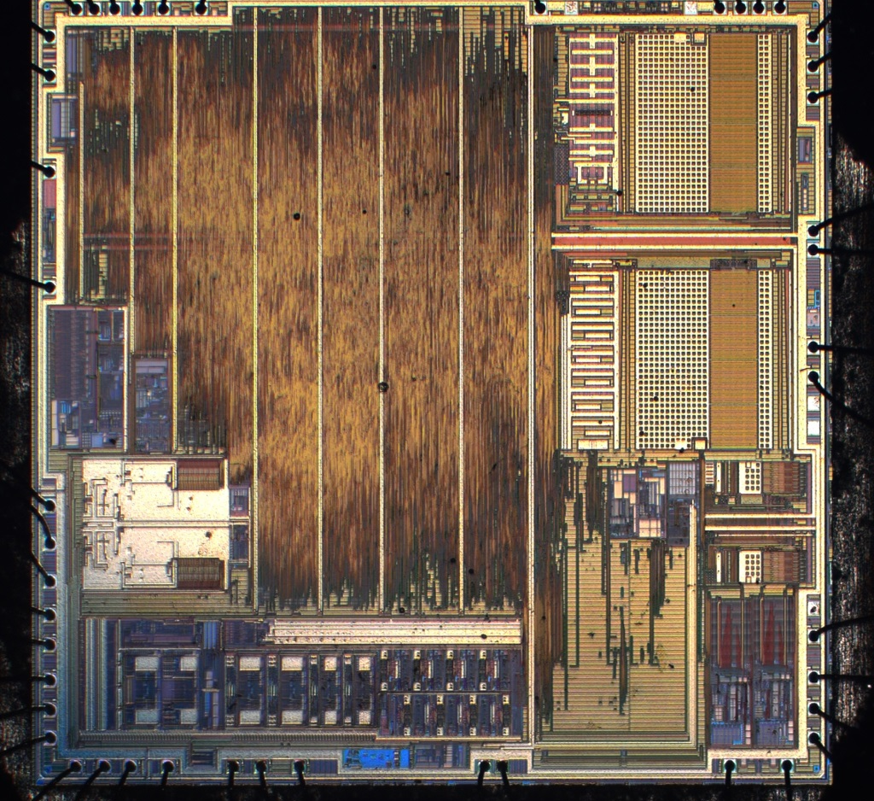
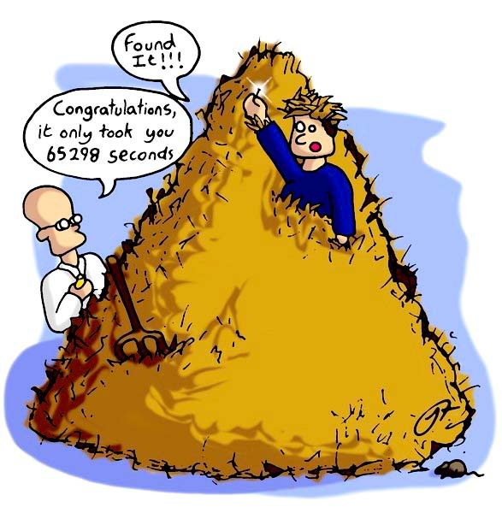
Voltage Contrast SCA
Motivation – The Haystack
Goal: Hardware Reverse Engineering
Straightforward Approach
  Sand-and-scan
  Netlist extraction
  Search Region-of-Interest (ROI)
Todays IC chips
  Millions of Gates
  ROI Location: Needle in the haystack
  Infeasible manual work
  http://edocumentsciences.com/wp-content/uploads/2011/10/Finding-A-Password-In-A-Haystack.jpg

Slide 4
Voltage Contrast SCA
Region of Interest – The Needle
Finding the ROI (Region of Interest) :
  Mandatory for Hardware Reverse Engineering
  Precise Fault Attacks
    Laser, UV light, EM induction, Probing, …
  Improves EM SCA
Multiple approaches suggested:
  EM cartography
  Photon Emission Images
  Surface Liquid Crystal
  Fault Attacks
  Voltage Contrast / E-Beam
AES??
FLASH
RAM
ANALOG IO

Slide 5
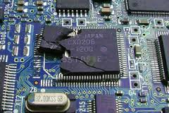
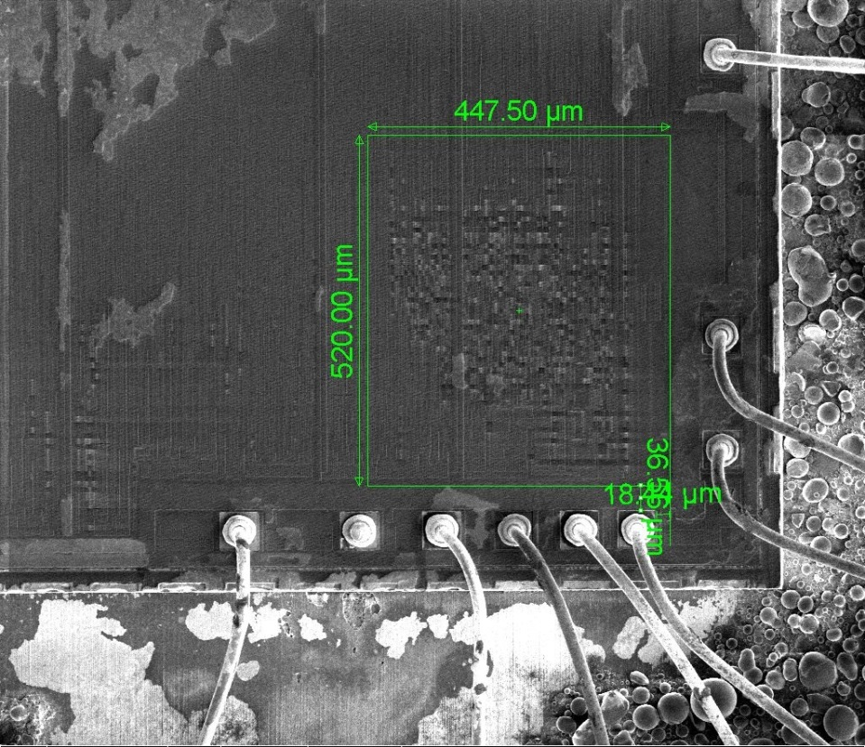
Voltage Contrast SCA
Voltage Contrast - Introduction
Voltage Contrast used for Failure Analysis
  Locate badly connected wires
  High resistance
  …
Negative charge of electrons in beams
  Commercial E-Beam Prober
    Very fast
    Expensive
    Non-contact voltmeter
  Scanning Electron Microscope (SEM)
    Slow
    Mid-cost
    Academically well distributed
http://www.nationalparts.com/pes/images/failure_analysis.jpg

Slide 6

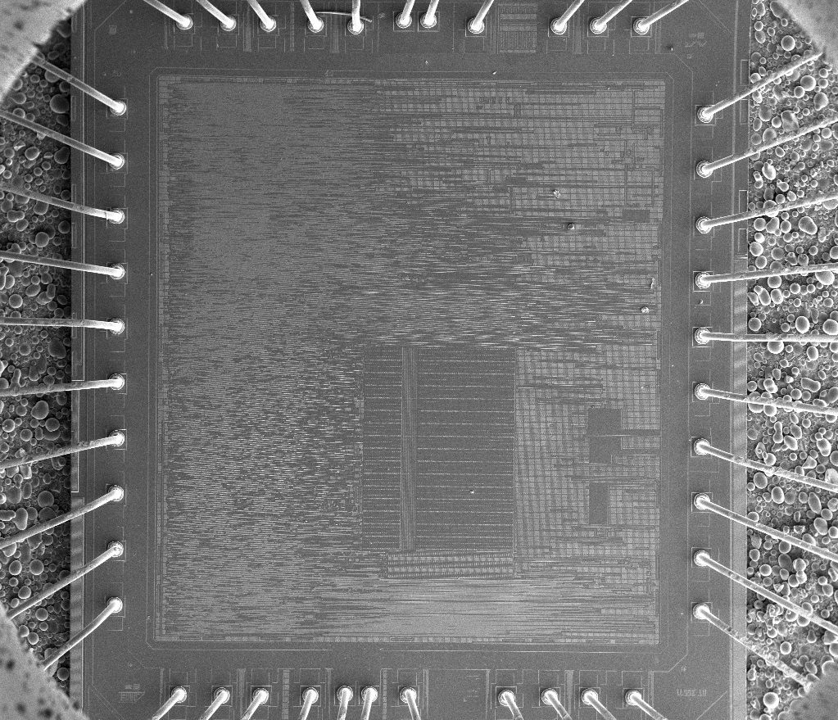
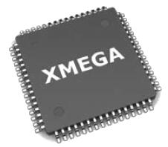
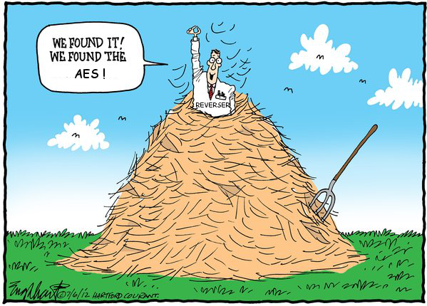
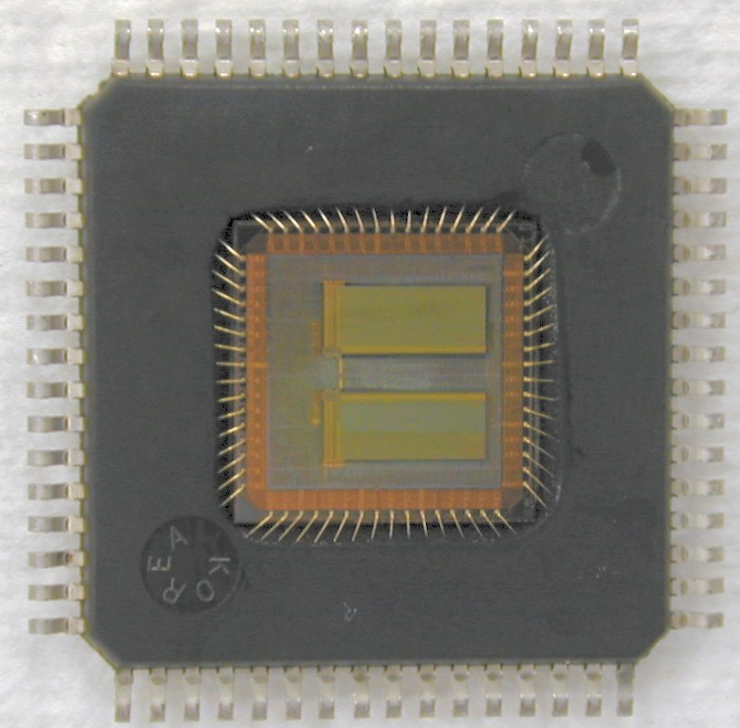
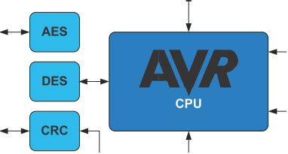
Voltage Contrast SCA
Voltage Contrast - ROI
Target: Atmel XMega
  AES Co-Processor
  Proof of Concept
Decap package
  Top layer visible
XMega in SEM vacuum chamber
Power-up device
Trigger AES
http://www.muanalysis.com/_documents/300%20series%20images/304.jpg
http://jeffreyhill.typepad.com/.a/6a00d8341d417153ef016768405219970b-800wi

Slide 7
Voltage Contrast SCA
Passive/Active Voltage Contrast
SEM
SEM
primary beam
primary beam
imaging
detector
imaging
detector
-
-
-
-
-
-
secondary electrons
-
-
-
-
-
-
-
secondary electrons
-
-
-
-
-
-
+
+
+
+
+
+
+
+
+
+
+
+
+
+
+
-
-
-
-
-
-
-
Structure
Grounded structure

Slide 8
Voltage Contrast SCA
VCA in a SEM
Neutral (not connected)
Working (cycle x)
Working (cycle x+1)
Slow SEM
  Some kHz
  External clock control!
Notes:
Suche nach einem Grashalm auf einem Fußballfeld
The effect of setting the lock bits by UV-light is used to find it’s location.
If the lock bit is set it is not under the mask. Otherwise it is in the covered area.
Using the effect of setting the lock bits by UV-light it is possible to find the location of interest.
Therefore we cover the half of the interesting area with an UV-absorbing mask, irradiate with UV-light for some minutes and read the lock bit.
If the lock bit is set we know that it is not under the mask. Otherwise it is in the covered area.
repeat this until the handling of the mask is to difficult.

Slide 9
Voltage Contrast SCA
Setup – Low Cost SEM Control
SEM Control PC
(2)
SEM (2)
primary beam
Keyboard
emulation
generated clock
Controller
(3)
setup
PC
(4)
DUT
(1)
USART
Notes:
Suche nach einem Grashalm auf einem Fußballfeld
The effect of setting the lock bits by UV-light is used to find it’s location.
If the lock bit is set it is not under the mask. Otherwise it is in the covered area.
Using the effect of setting the lock bits by UV-light it is possible to find the location of interest.
Therefore we cover the half of the interesting area with an UV-absorbing mask, irradiate with UV-light for some minutes and read the lock bit.
If the lock bit is set we know that it is not under the mask. Otherwise it is in the covered area.
repeat this until the handling of the mask is to difficult.

Slide 10
Voltage Contrast SCA
Capacitive Coupled Voltage Contrast
Capacitive Coupled Voltage Contrast
  With passivation
  2 phases separated by a cycle
    Charge
    (Clock cycle)
    Evaluate
External clock control!
Schematic
Top metal layer
Wire
Wire
2nd metal layer
dielectric
SiO₂
Wire
Notes:
Suche nach einem Grashalm auf einem Fußballfeld
The effect of setting the lock bits by UV-light is used to find it’s location.
If the lock bit is set it is not under the mask. Otherwise it is in the covered area.
Using the effect of setting the lock bits by UV-light it is possible to find the location of interest.
Therefore we cover the half of the interesting area with an UV-absorbing mask, irradiate with UV-light for some minutes and read the lock bit.
If the lock bit is set we know that it is not under the mask. Otherwise it is in the covered area.
repeat this until the handling of the mask is to difficult.

Slide 11
Voltage Contrast SCA
Capacitive Coupled VC – Phase 1
SEM
primary beam
accumulated charge
-
-
-
-
-
-
-
-
-
-
-
-
-
-
-
-
-
-
-
-
-
-
-
+
+
+
+
+
+
+
+
Top metal layer
-
+
GND
+3 V
-
-
-
-
-
-
-
-
-
-
-
-
-
-
-
-
-
-
-
-
Secondmetal
layer
dielectric
SiO₂
+
+3 V
Schematic
Notes:
Suche nach einem Grashalm auf einem Fußballfeld
The effect of setting the lock bits by UV-light is used to find it’s location.
If the lock bit is set it is not under the mask. Otherwise it is in the covered area.
Using the effect of setting the lock bits by UV-light it is possible to find the location of interest.
Therefore we cover the half of the interesting area with an UV-absorbing mask, irradiate with UV-light for some minutes and read the lock bit.
If the lock bit is set we know that it is not under the mask. Otherwise it is in the covered area.
repeat this until the handling of the mask is to difficult.

Slide 12
Voltage Contrast SCA
Capacitive Coupled VC – Phase 2
Note: Clock cycle takes place
SEM
(accumulated)
secondary electrons
primary beam
-
-
-
-
-
-
-
-
-
-
-
-
-
-
-
-
-
-
-
-
-
-
-
-
-
+
+
+
+
+
+
+
+
Top metal layer
-
+
GND
+3V
-
-
-
-
-
-
-
-
-
-
-
-
-
-
-
-
-
-
-
Secondmetal
layer
dielectric
SiO₂
-
GND
Schematic
Notes:
Suche nach einem Grashalm auf einem Fußballfeld
The effect of setting the lock bits by UV-light is used to find it’s location.
If the lock bit is set it is not under the mask. Otherwise it is in the covered area.
Using the effect of setting the lock bits by UV-light it is possible to find the location of interest.
Therefore we cover the half of the interesting area with an UV-absorbing mask, irradiate with UV-light for some minutes and read the lock bit.
If the lock bit is set we know that it is not under the mask. Otherwise it is in the covered area.
repeat this until the handling of the mask is to difficult.

Slide 13
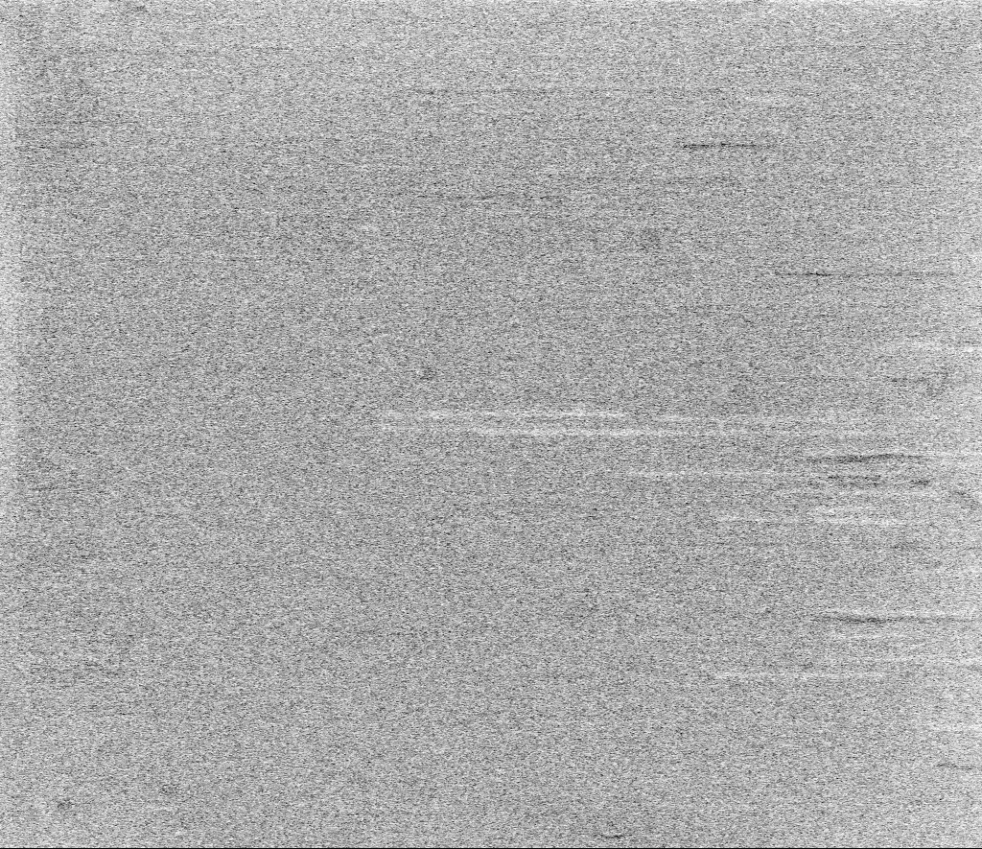
Voltage Contrast SCA
A Single Tracevideo – 5 Frames / 1 Clock cycle
Notes:
Suche nach einem Grashalm auf einem Fußballfeld
The effect of setting the lock bits by UV-light is used to find it’s location.
If the lock bit is set it is not under the mask. Otherwise it is in the covered area.
Using the effect of setting the lock bits by UV-light it is possible to find the location of interest.
Therefore we cover the half of the interesting area with an UV-absorbing mask, irradiate with UV-light for some minutes and read the lock bit.
If the lock bit is set we know that it is not under the mask. Otherwise it is in the covered area.
repeat this until the handling of the mask is to difficult.

Slide 14
Voltage Contrast SCA
Proof-of-Concept
T₁
T₂
T…
T₃₀₀
We know:
  Key
  Plaintext/Ciphertext
Traces:
  Tracevideo frames
Pearson correlation
  Hamming Weight model
    Intermediate AES bits and raw VCSCA videoframe
    2-bit logic functions of intermediate bits ( SCA Reverse Engineering)
    Simple Side Channel Analysis (single trace, nor plain/key known)
Trace Acquisition
  300 Traces
  ~3 Hz external clock
Tracevideos
Frames
F₁
F₂
F…
F_{n}
Intermediate AES bits
Located correlation frame
Correlate

Slide 15
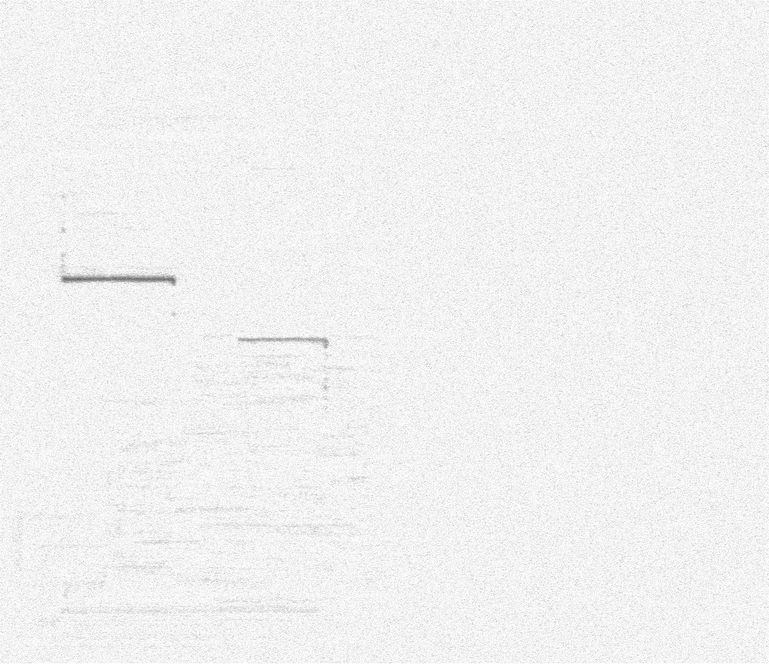
Voltage Contrast SCA
Results – Locate Bit 1 of Subbytes Byte 1
Frame 48
  Subbytes
  Byte X
  Bit 1
Sequentially byte-wise pipelined
Common Load/Store Unit
Frame 48
  Subbytes
  Byte 1
  Bit 1

Slide 16
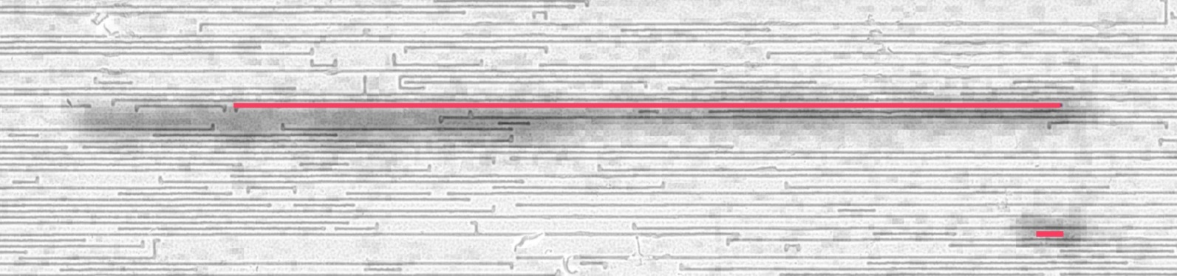
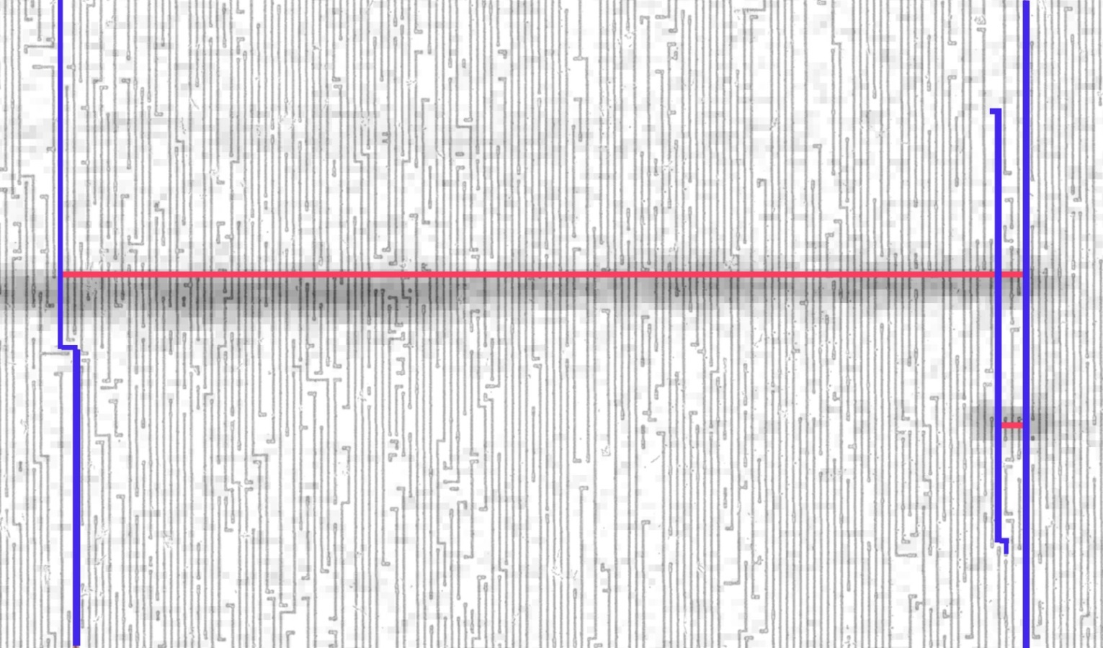
Voltage Contrast SCA
Results - Hardware Reverse Engineering
SEM pictures
  1st and 2nd layer
  Overlayed with 50% transparent result (dark cloud)
Align and Trace down
  DFFs
  …
Mark in extracted netlist

Slide 17

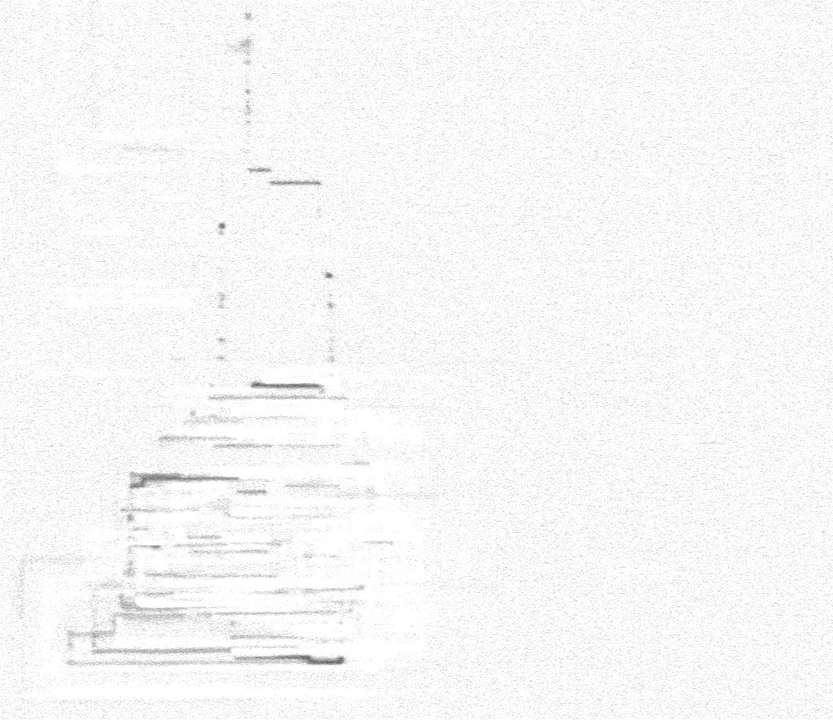
Voltage Contrast SCA
Results – Correlation Attack
New Assumption:
  Key unknown
  Known plaintext
Aquire 100 Traces
Key Hypothesis
  Set to 1
  Correlation close to -1 or +1
Full AES-128 key recovered

Slide 18
Voltage Contrast SCA
Conclusion
Voltage Contrast is mid-cost
  Scanning Electronic Microscope
    Widely available in academia
    Second hand for < €10k
  Low cost adjustment
Hardware Reverse Engineering tool
  Pinpoint ROI within minutes
  Front side
    Might be shielded
Powerful Side Channel (VCSCA)

Slide 19
Voltage Contrast SCA
Future Work
Hardware Reverse Engineering Tool
  Optimize the setup
    Faster
    Less noisy
  Verify netlist assumptions
Hardware Debugging tool?
Research shows feasibility of backside CCVC[1]
[1] Schlangen et.al, Backside e-beam probing on nano scale devices, Journal of Materials Science: Materials in Electronics

Slide 20
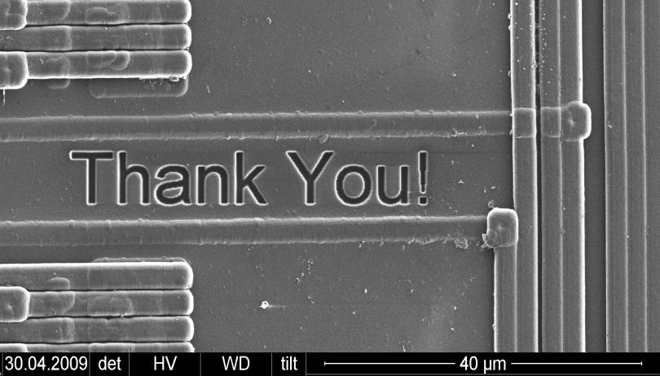
Thank You!
Questions?

