Slide 1
Stealing Keys from PCs using a Radio: Cheap Electromagnetic Attacks on Windowed Exponentiation
Daniel Genkin
Technion and Tel Aviv University
joint work with
Lev Pachmanov
Tel Aviv University
Itamar Pipman
Tel Aviv University
Eran Tromer
Tel Aviv University

Slide 2
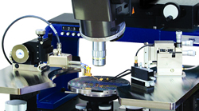
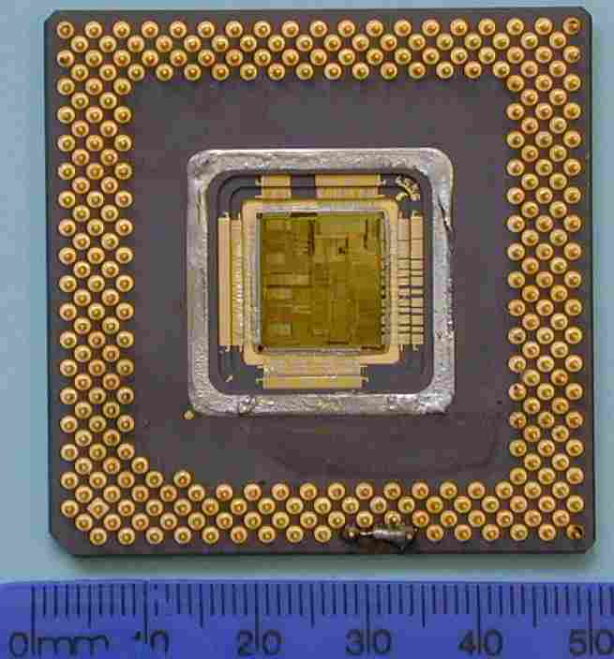
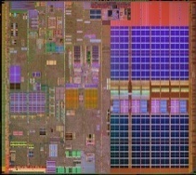
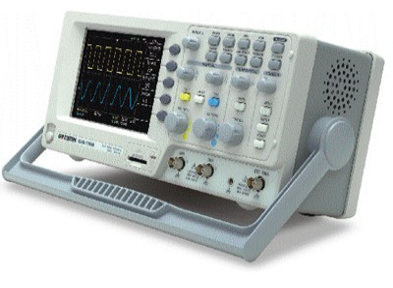
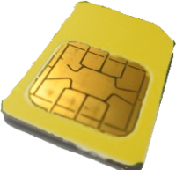
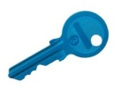
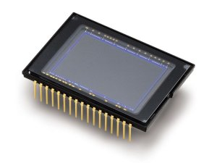
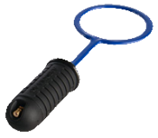
Side channel attacks
probing
CPU architecture
optical
power
electromagnetic
Notes:
Fix power analysis fluke

Slide 3
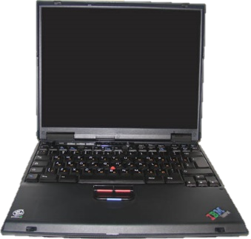
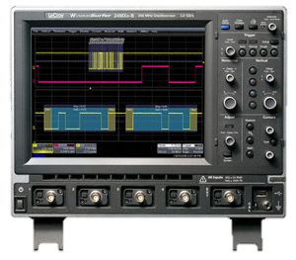
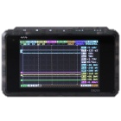
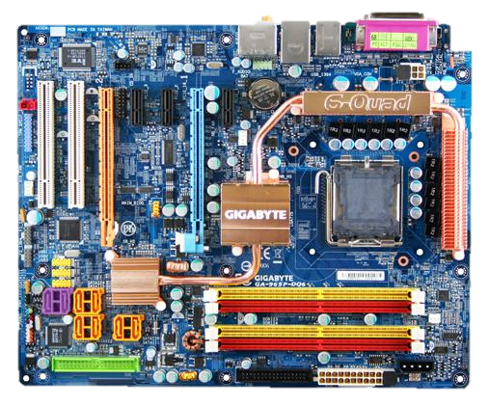
Problems with Attacking PCs
Different scenario
Not handed out to the adversary
Attacker needs to be swift and inconspicuous
Speed
2GHz CPU
Clock-rate attacks requires expansive and bulky equipment (compared to a 100 MHz smart card)
Complexity & Noise
Complex electronics running complicated software (in parallel)
vs.
vs.
$1,000
$100,000
vs.

Slide 4
Physical side-channel attacks on PCs
Non-cryptographic: [Oren Shamir 06], [Clark Mustafa Randford Sorber Fu Xu 13], [Zajic Prvulovic 14], [Guri Kachlon Hasson Kedma Mirsky Elovici 15] [Guri Monitz Mirski Elovici 15], [Masti Rai Ranganathan Muller Thiele Capkun 15]
Cryptographic:
Algorithm | Attack type | #ciphertexts | Time | BW | Cipher | Ref
SQR-and- always-MUL | Adaptive chosen ciphertext | $$\frac{Key size}{4}$$ | 1 hour | 50 kHz | RSA | [Genkin Shamir Tromer’14]

Slide 5
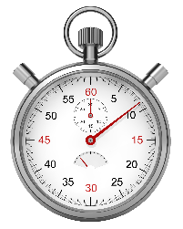
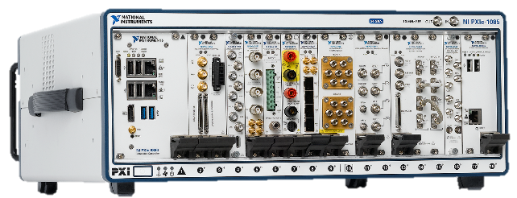
Physical side-channel attacks on PCs
Non-cryptographic: [Oren Shamir 06], [Clark Mustafa Randford Sorber Fu Xu 13], [Zajic Prvulovic 14], [Guri Kachlon Hasson Kedma Mirsky Elovici 15] [Guri Monitz Mirski Elovici 15], [Masti Rai Ranganathan Muller Thiele Capkun 15]
Cryptographic:
Modern implementations use windowed exponentiation (fixed or sliding window)
Attacks require either:
simple equipment , slow
lots of expensive equipment, fast
Algorithm | Attack type | #ciphertexts | Time | BW | Cipher | Ref
SQR-and- always-MUL | Adaptive chosen ciphertext | $$\frac{Key size}{4}$$ | 1 hour | 50 kHz | RSA | [Genkin Shamir Tromer’14]
SQR-and- always-MUL | Non-adaptive chosen ciphertext | $$1$$ | 3 sec | 2 MHz | ElGamal, RSA | [Genkin Pipman Tromer’14]

Slide 6
Physical side-channel attacks on PCs
Non-cryptographic: [Oren Shamir 06], [Clark Mustafa Randford Sorber Fu Xu 13], [Zajic Prvulovic 14], [Guri Kachlon Hasson Kedma Mirsky Elovici 15] [Guri Monitz Mirski Elovici 15], [Masti Rai Ranganathan Muller Thiele Capkun 15]
Modern implementations use windowed exponentiation (fixed or sliding window)
Attacks require either:
simple equipment , slow
lots of expensive equipment, fast
Cryptographic:
Algorithm | Attack type | #ciphertexts | Time | BW | Cipher | Ref
SQR-and- always-MUL | Adaptive chosen ciphertext | $$\frac{Key size}{4}$$ | 1 hour | 50 kHz | RSA | [Genkin Shamir Tromer’14]
SQR-and- always-MUL | Non-adaptive chosen ciphertext | $$1$$ | 3 sec | 2 MHz | ElGamal, RSA | [Genkin Pipman Tromer’14]

Slide 7
Physical side-channel attacks on PCs
Cryptographic:
This work:
Equipment cost: <$300
can be done with a simple radio
Effective on common cryptographic software
GnuPG 1.4.18, CVE 2014-3591
Algorithm | Attack type | #ciphertexts | Time | BW | Cipher | Ref
SQR-and- always-MUL | Adaptive chosen ciphertext | $$\frac{Key size}{4}$$ | 1 hour | 50 kHz | RSA | [Genkin Shamir Tromer’14]
SQR-and- always-MUL | Non-adaptive chosen ciphertext | $$1$$ | 3 sec | 2 MHz | ElGamal, RSA | [Genkin Pipman Tromer’14]
Sliding window | Non-adaptive chosen ciphertext | 8 or 16 ($2^{w−1}$ for $w$-bit window) | 30 sec | 100 kHZ | ElGamal, RSA | This paper
Fixed window

Slide 8
Attacking ElGamal

Slide 9
ElGamal encryption
Key setup
pk: prime $p$, generator $g$ for $Z_{p}^{∗}$, $h=g^{x} mod p$ for a random $x∈Z_{p}^{∗}$.
sk: $x$
Decryption
$$s=c_{1}^{x} mod p$$
$$m=c_{2}⋅s^{−1} mod p$$
Encryption
$$c_{1} =g^{y} mod p$$
$c_{2}=m⋅h^{y} mod p$

Slide 10
Fixed-window modular exponentiation
modular_exponentiation(c,x,p){
// Compute lookup table: a[0] = 1
a[1] = c mod p
a[2] = c² mod p
…
a[i] = c^{i} mod p
…
a[2^{w}] = c mod p
// Process x in blocks:
m=1, j=1
while (j $≤$ n) do
for k=1 to w do
m = m² mod p
m = m*a[x_{j}…x_{j+w}] mod p
j=j+w+1
return m
}
depends on both x_{j}…x_{j+w} and$c$ and is used for mult
craft $c$ to affect the mult, based on x_{j}…x_{j+w}
2^{w}
measure changes inside mult operation and obtain x_{j}…x_{j+w}
2GHz CPU speed vs. 100kHz measurements
can only see drastic changes inside mult operation
Idea: leakage self-amplification
abuse algorithm’s own code to amplify its own leakage!
Craft suitable cipher-text to affect the inner-most loop
Small differences in repeated inner-most loops cause a big overall difference in code behavior

Slide 11
Fixed-window modular exponentiation
karatsuba_mult(a,b){
…
basic_mult(a,b)
…
}
modular_exponentiation(c,x,p){
// Compute lookup table: a[0] = 1
a[1] = c mod p
a[2] = c² mod p
…
a[i] = c^{i} mod p
…
a[2^{w}] = c mod p
// Process x in blocks:
m=1, j=1
while (j $≤$ n) do
for k=1 to w do
m = m² mod p
m = m*a[x_{j}…x_{j+w}] mod p
j=j+w+1
return m
}
basic_mult(a,b){
…
}
if (b[j]==0)
continue else return b[j]*a
~x9
~x7
2^{w}
repeated ~200 times per mult
~0.2ms of measurements per mult
Recover the key by poisoning each table index, one at a time
For each $1≤i≤2^{w}$:
Choose $c$ s.t: $a[i]=c^{i} mod p$ has many zero limbs
Every time that x_{j}…x_{j+w} = $i$ the second operand has many zero limbs
Measure and deduce occurrences of $i$ in secret key

Slide 12
Demo: ElGamal key extraction

Slide 13
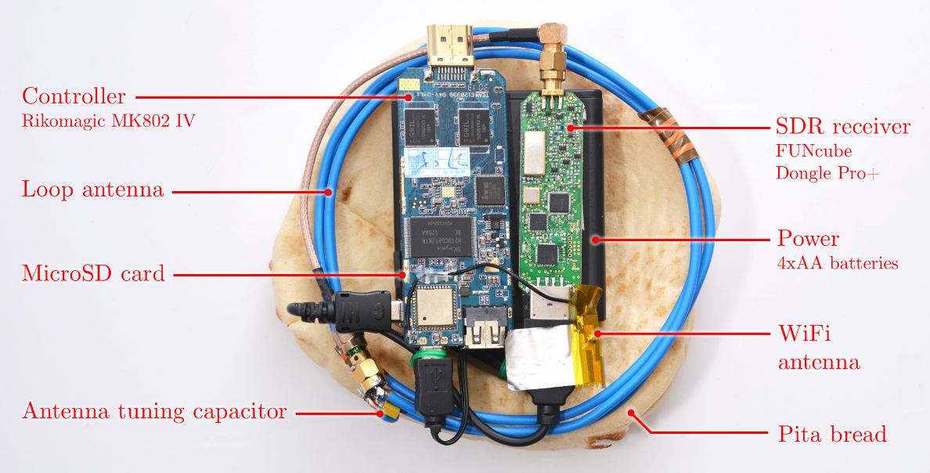
Portable Instrument for Trace Acquisition (PITA)
Cost: $300

Slide 14
Electromagnetic attacks

Slide 15
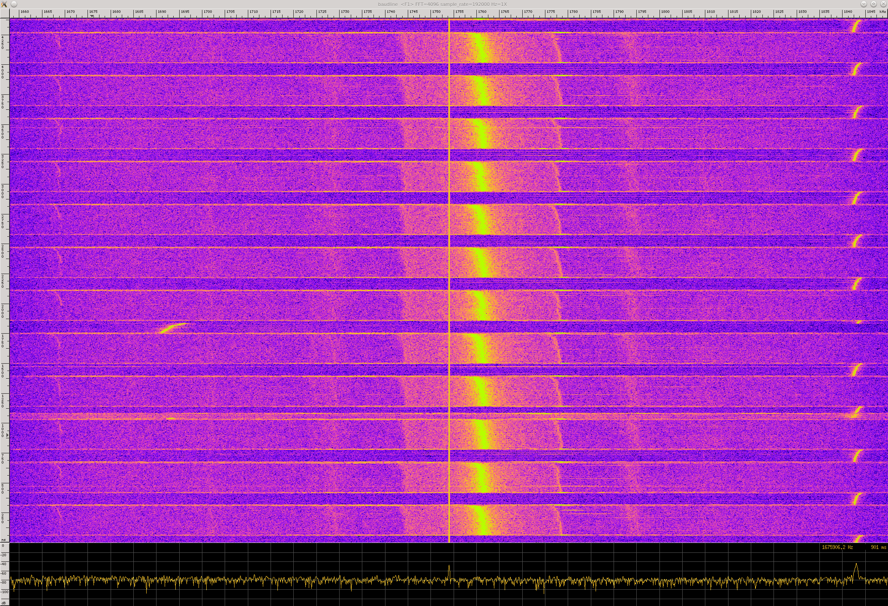
Leaking the secret key
carrier
FM-modulated key
due to multiplications of a random-looking /
mostly zero limb value of $m$

Slide 16
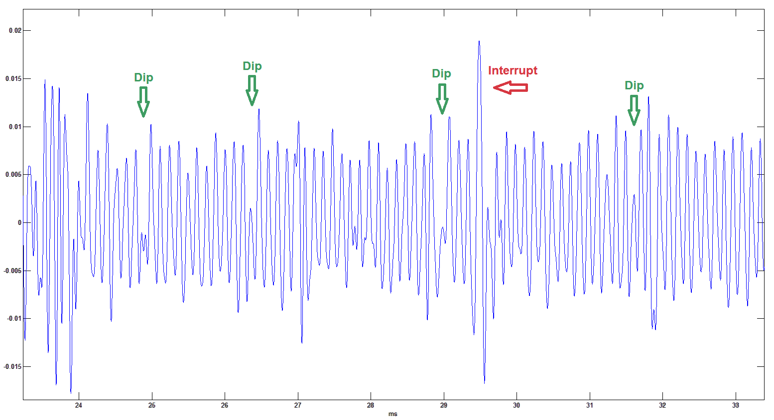
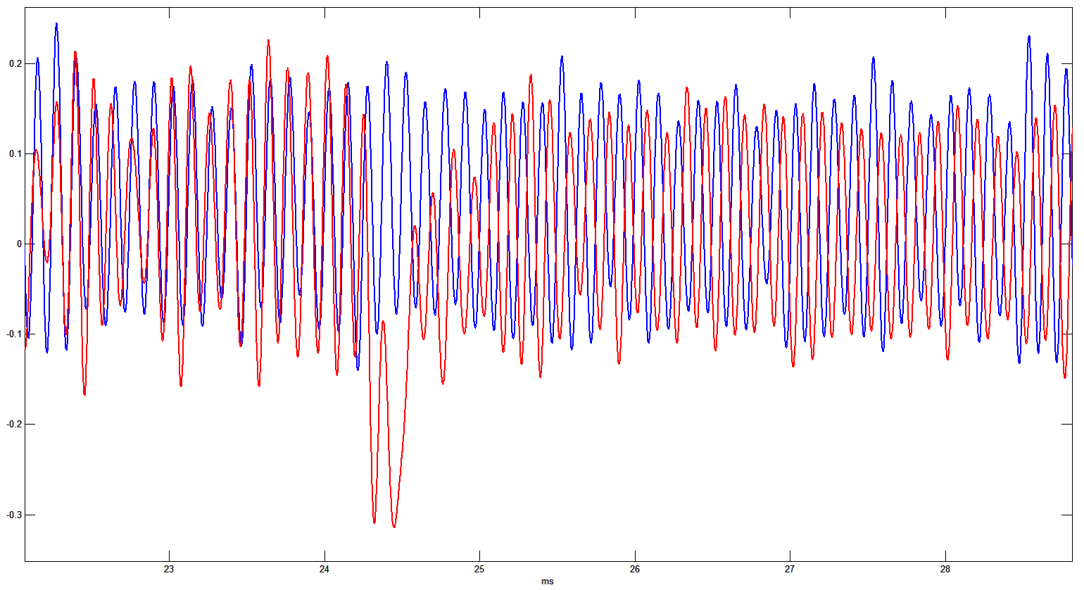
ElGamal Key Extraction
After frequency demodulation
Corruptions every ~15ms (corresponding to the time interrupt)
Gradual drifts

Slide 17
ElGamal Key Extraction
After frequency demodulation
Corruptions every ~15ms (corresponding to the time interrupt)
Gradual drifts
After averaging (ignoring corruptions and correcting drifts)
After equalization

Slide 18
ElGamal Key Extraction
Window value
0x1
0x3
0x5
x=???????5??3?3?1?????????5????5??????5????3??????5???5???????

Slide 19
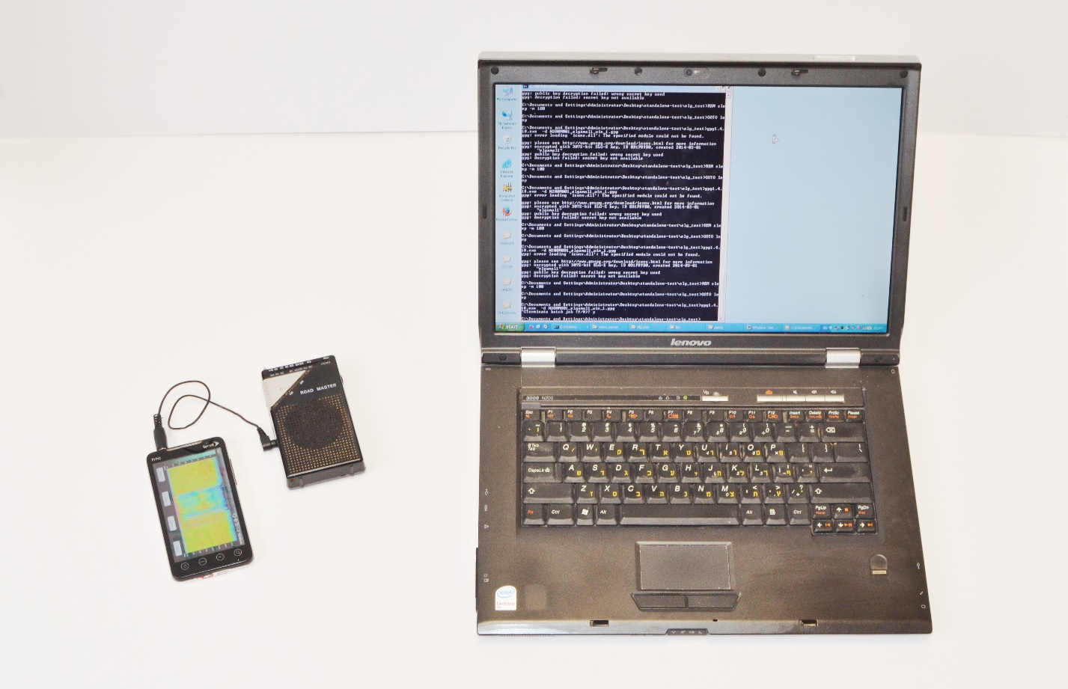
Key extraction via commodity radio receiver

Slide 20
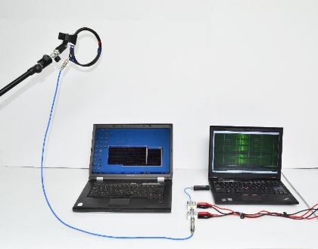
Key extraction from 50cm away

Slide 21
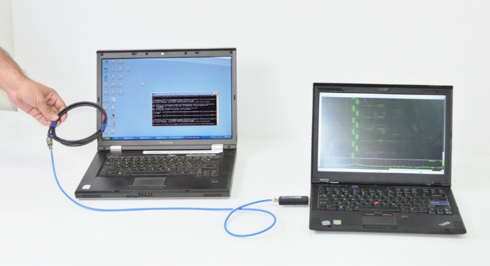
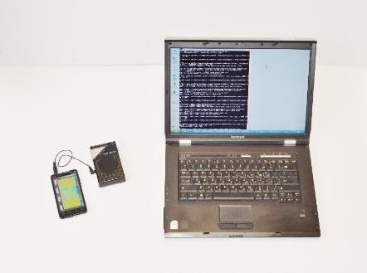
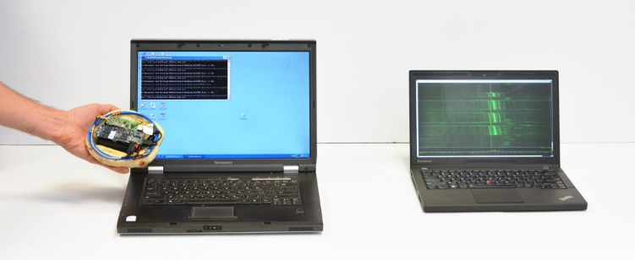
Thanks!
tau.ac.il/~tromer/radioexp

Slide 22
Thanks!
tau.ac.il/~tromer/radioexp

Slide 23
Thanks!
tau.ac.il/~tromer/radioexp

Slide 24
Thanks!
tau.ac.il/~tromer/radioexp

Slide 25
Thanks!
tau.ac.il/~tromer/radioexp

