Slide 1
Accelerating Homomorphic Evaluation on Reconfigurable Hardware
Thomas Pöppelmann, Michael Naehrig, Andrew Putnam, Adrian Macias

Slide 2
Outline
1
Motivation
2
Somewhat Homomorphic Encryption
3
Implementation
4
Results
5
Conclusion

Slide 3
Outline
1
Motivation
2
Somewhat Homomorphic Encryption
3
Implementation
4
Results
5
Conclusion

Slide 4
Motivation: Secure Computation
Homomorphic encryption allows computation on data without revealing the data itself to the entity performing the computation
Premium example: cloud computing
Clients encrypt data and store encrypted data in the cloud
The cloud server performs computation but an attacker (malicious admin, hacker, intelligence agency) cannot see the actual data
The client just gets the result
Practical usable for specialized, high risk, or privacy sensitive applications
Genomic data processing
Medical data processing
Machine learning

Slide 5
Motivation: Homomorphic evaluation
5
?
Evaluation
Encrypt
MUL
MUL
?
Decrypt
1500
10
Encrypt
?
ADD
ADD
?
Decrypt
80
20
Encrypt
?
SW
Untrusted environment, e.g., the cloud
SW
This work: How can we use FPGAs to accelerate
homomorphic evaluation?

Slide 6
Outline
1
Motivation
2
Somewhat Homomorphic Encryption
3
Implementation
4
Results
5
Conclusion

Slide 7
YASHE
YASHE [BLLN’13]: Yet Another Somewhat Homomorphic Encryption scheme
For each evaluation operation (addition/multiplication) noise in cipher text grows
At some point the noise gets too large and original message cannot be recovered anymore => manage noise growth
Somewhat homomorphic scheme (SHE) => amount of computations is limited by choice of parameters
Security based on decisional small polynomial ratio (DSPR) and ring learning with errors assumption (RLWE)
Operations on (large) polynomials
$R=Z\left[x\right]/<x^{n}\text{+1>}$
$R_{q}=Z_{q}\left[x\right]/<x^{n}\text{+1>}$
[BLLN’13] ]Joppe W. Bos, Kristin Lauter, Jake Loftus, Michael Naehrig: Improved Security for a Ring-Based Fully Homomorphic Encryption Scheme. IMACC 2013,

Slide 8
YASHE’ Algorithms
Setup and encryption/decryption:
ParamsGen($λ$): Generate parameters based on a security parameter $λ$
KeyGen(params): Generate a public key $h,$a private key $f$, and evaluation key $evk=\sum_{i=0}^{l−1}{{evk}_{i}}$
Encrypt(${m ∈R}_{t}$): The message space is $R_{t}$ for a small $t$. Sample noise vectors $s,e$. Return $c=m+e+h∙s{ ∈R}_{q}$
Decrypt($c{ ∈R}_{q}$): Return $m=[f∙c$ ${ ∈R}_{q}$] mod t.
Ciphertext evaluation:
Add($c_{1},$ $c_{2}):$ Return${: c}_{1}+c_{2}{∈R}_{q}$
Mult($c_{1},{ c}_{2}, evk):$ Compute $c_{mult}=$ RMult($c_{1}, c_{2}$) and return KeySwitch($c_{mult}$, $evk$)
RMult($c_{1}, c_{2}$): return $\left[\left\lceil \left.\frac{t}{q}c_{1}∙c_{2}∈R\right\rfloor \right.\right]mod q$
KeySwitch($c_{mult}$, $evk$) : Return $c=\sum_{i=0}^{l−1}{{{[c_{mult}]}_{i}∙evk}_{i}}$

Slide 9
YASHE RMult
Ciphertext evaluation:
$c_{mult}=$ $\left[\left\lceil \left.\frac{t}{q}c_{1}∙c_{2}∈R\right\rfloor \right.\right]mod q$
Reduction modulo $\left\langle x^{n}+1\right\rangle$ but no mod q
c’
$$\frac{t}{q}$$
$$c_{1}$$
$$c_{2}$$
$$c_{mult}$$
log(q)
$$∙$$
$$=$$
$$\frac{t}{q}$$
$$mod q$$
$$=$$
n
polynomial
multiplication
Multiplication by scalar and rounding

Slide 10
YASHE KeySwitch
Ciphertext evaluation:$c=\sum_{i=0}^{l−1}{{{[c_{mult}]}_{i}∙evk}_{i}}$
Size determined by parameter window parameter $w$
$$𝒞_{0}$$
$${evk}_{0}$$
$$∙$$
$$𝒞_{1}$$
$${evk}_{1}$$
$$∙$$
$$c_{mult}$$
$$c$$
$$∑$$
$$𝒞_{2}$$
$$∙$$
$${evk}_{2}$$
$c_{mult}$ is split into several polynomials
$$𝒞_{3}$$
$${evk}_{3}$$
$$∙$$
Several polynomial multiplications by constant evaluation key

Slide 11
YASHE (Selected) Parameters
Description | Parameter | Set-I | Set-II
Polynomial coefficients | n | 4096 | 16384
Modulus | q | $$2^{124}−2^{64}+1$$ | $$2^{512}−2^{32}+1$$
Plaintext space | t | 1024 | 1024
Windows size | w | $$2^{64}$$ | $$2^{64}$$
Evaluation keys | q/w | 1 | 8
Supported multiplications (levels) | L | 1 | 9
Size of one polynomial | - | 62 KB | 1 MB
Size of evaluation key | - | 124 KB | 8 MB
Parameters are supposed to provide at least 80 bits of security

Slide 12
Outline
1
Motivation
2
Somewhat Homomorphic Encryption
3
Implementation
4
Results
5
Conclusion

Slide 13
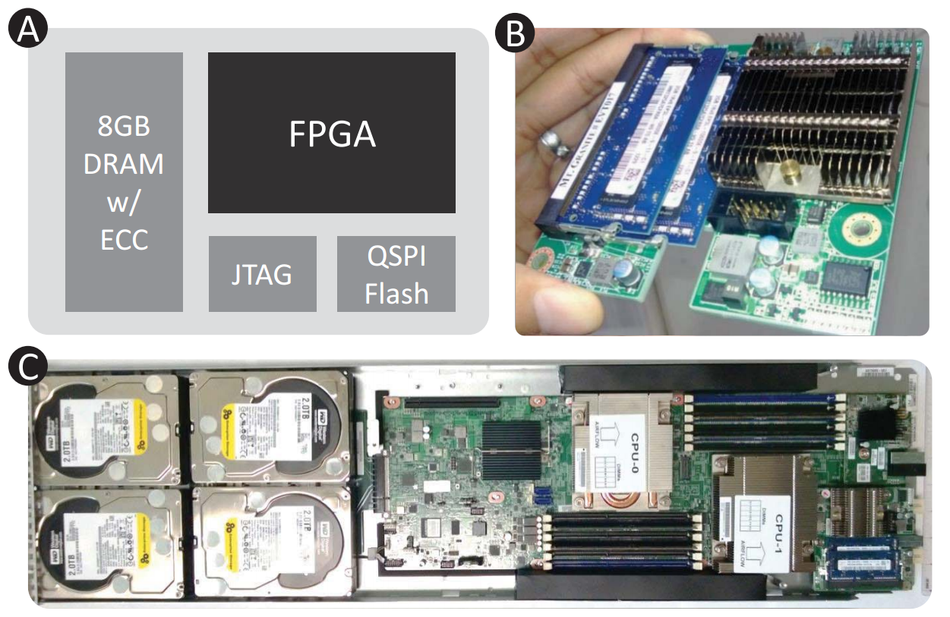
Target Platform: Catapult
Microsoft project [PCC+14] to accelerate cloud services using Altera Stratix V FPGAs
Each server contains an FPGA
FPGAs are connected by complex dedicated communication network
2x throughput over software-only Bing ranking in 1632 server/FPGA prototype
Of independent interest to CHES community
[PCC+14] Andrew Putnam et al, A Reconfigurable Fabric for Accelerating Large-Scale Datacenter Services. ISCA 2014

Slide 14
Implementation Challenges on FPGAs
Target device: Stratix V
172,600 ALMs (logic blocks)
4.9 MB internal memory
1590 embedded multipliers
Implementation Challenge
Usage of external memory
Large multipliers required (e.g., 512x512-bits)
Development more complex
FPGA
(4 MB)
DRAM0
(4 GB)
DDR
PC
PCIe
DRAM1
(4 GB)
DDR
Evaluation operations

Slide 15
Number Theoretic Transform
Polynomial multiplication using the number theoretic transform (NTT)
NTT is a fast Fourier transformation (FFT) in $Z_{q}$ (no complex or floating point numbers)
$a·b=\text{INTT}\left(\text{NTT}\left(a\right)∘\text{NTT}\left(b\right)\right)$with $a,b∈R_{q}$
Using a certain scaling we do not need zero padding (we can multiply $n$ coefficient polynomials using n-point NTT)

Slide 16
Cached-NTT
Cached-NTT
Splits computation of NTT into two epochs
Performs computation locally on groups
After all groups of one epoch are computed a reordering step is necessary
$\frac{n}{2}log\left(n\right)$ multiplications by constants (twiddle factors)
$n log(n)$ additions/subtractions

Slide 17
Architecture
NttCore computes one or several groups of NTT in parallel
NTTButterfly implements pipelined 512x512-bit multiplier (supports also 1040x1040-bit in 4 cycles)
Dual buffering of data set in FPGA to support computation and memory access in parallel
Microcode engine wit approx. 15 instructions

Slide 18
Outline
1
Motivation
2
Somewhat Homomorphic Encryption
3
Implementation
4
Results
5
Conclusion

Slide 19
Results
Implementation | Mult | Add
Set I (n=4096) @100 MHz | 675,326 cycles | 19,057 cycles
 | 6.75 ms | 0.19 ms
Set II (n=16384) @66 MHz | 3,212,506 cycles | 61,775 cycles
 | 48.67 ms | 0.94 ms
SET II implementation requires 141,090 (82%) ALMs, 577 (36%) DSPs and 17,626,400 (43%) BRAM bits on Altera Stratix V
Congested design and constraints of DRAM and PCIe controller result in relatively low clock frequency
Cycle counts measured online to account for DRAM latency

Slide 20
Comparison
Author | Parameter | Architecture | Mult | Add
Our work | YASHE, n=16384 | FPGA (Stratix 5) | 49 ms | 1 ms
[LN’14] | YASHE, n=4096 | 3.5 GHz Intel i7 | 49 ms | 0.7 ms
[RJVDV’15] | YASHE, n=32768 | FPGA (Virtex-7) | 112 ms | 0.17 ms
Schemes and parameters differ widely
Costs of FPGAs are hard to compare (FPGA+I/O+board)
Numerous ASIC, GPU implementations published while schemes got better and better
[LN14] Tancrède Lepoint, Michael Naehrig: A Comparison of the Homomorphic Encryption Schemes FV and YASHE. AFRICACRYPT 2014
[RJVDV’15] Roy et al. Modular Hardware Architecture for Somewhat Homomorphic Function Evaluation. CHES 2015

Slide 21
Outline
1
Motivation
2
Somewhat Homomorphic Encryption
3
Implementation
4
Results
5
Conclusion

Slide 22
Conclusion
Cached-FFT/NTT solves problem of limited on-chip memory
Large multiplier (1040x1040) is a bottleneck => Chinese remainder theorem (see next talk)
Biggest effort/time was spend on external memory interface
Has to be taken into account for evaluation of costs and performance
Simulation and debugging more complex

Slide 23
Future Work
Further evaluation of different implementation techniques (maybe CRT+cached-NTT)
Exploration of different and larger parameter sets
Can evaluation operations (MUL/ADD) be performed directly in frequency (NTT/FFT) domain
Multi-FPGA design or specialized board
FPGA
RAM
FPGA
FPGA
RAM
RAM
RAM

Slide 24
Thank You
Thank you for your attention!
Any Questions?
Contact:
thomas.poeppelmann@Infineon.com
Full paper:
https://eprint.iacr.org/2015/631

