Slide 1
Most Important thing in black box test
Korea University
Seokhie Hong, Taewon Kim, Sangyub LEE
CHES Rump Session, September, 15th, 2015

Slide 2
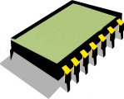

I’m in printer
AES
Come at me Bro
CHIP
Break me now
Notes:
=

Slide 3
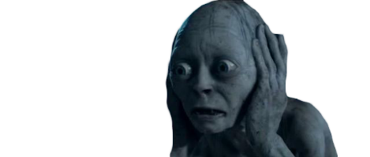

STRESS
My Precioussssssss
STRESS
My Precioussss
FEAR
My Preciousss
NERVOUS
ANXIETY
My Preciouss
WORRY
My Precious

Slide 4

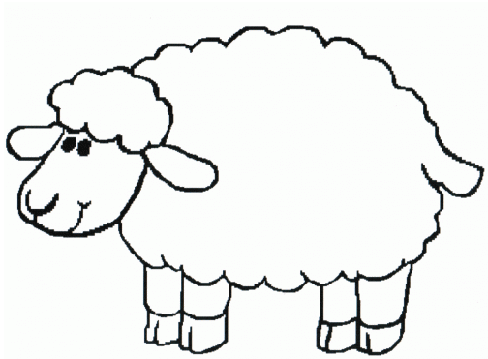


Slide 5
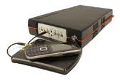


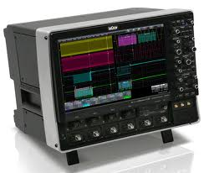
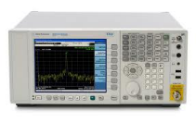
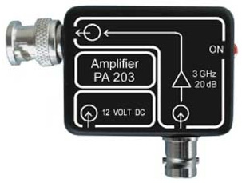

STEP 1
command
response
Reader
PC
iteration
Power
EM
store signals
filtered signal
Measuring
weak signal
Oscilloscope
Band Pass Filter
Amplifier
STEP 2
STEP 3
Visual inspection
Alignment(horizontal/vertical)
Compression
Principal Component Analysis
Linear Discrimination Analysis
Frequency domain

Slide 6

……as always
Key doesn’t come out easily…
Countermeasure?
SNR?
Power Model??
Any others??

Slide 7
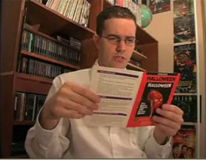
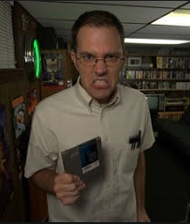
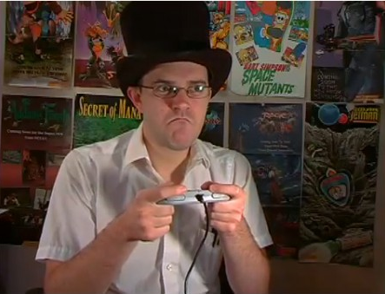




Let me see...
THIS MIGHT BE IT!!!!
GO Go GO!!!
Don’t care
FFFFFFFFFFFFFFFFFFFFFF
WHY NOT??!!!!
I’m cool
Not going good…

Slide 8

Where is my key
Where is my peaks

Slide 9
At last ..4 month later
After many trials and errors…
We finally found ‘the KEY’ at last..

Slide 10
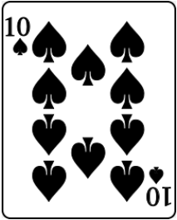
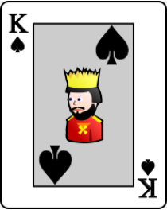

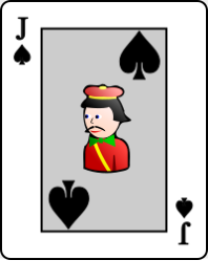
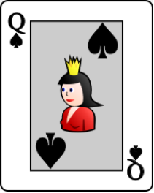
Pre-processing
Power Model
Distinguisher
Enough Trace

Slide 11
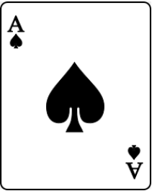
Pre-processing
Power Model
Most
important
thing is...
King
of
Mental
Distinguisher
Enough Trace

Slide 12

Thank you

